Slide 1


Design, Front-End | April 26, 2023
Mobile accessibility: building accessible mobile sites and native apps for accessibility
Gian Wild
CEO
at AccessibilityOz
@accessibilityoz

Slide 2

*Edit This* Thank you slide - purple.
CONTRIBUTION DAY
Friday 10am to 4pm
You don't have to know code to give back!
New Contributor training 10am to Noon
with AmyJune Hineline of Opensource.com

Slide 3


Drupal Coffee Exchange
at MidCamp
Bring a bag of beans,
Leave with a bag of beans.
That’s how it works.
MidCamp is in Chicago April 26-28

Slide 4
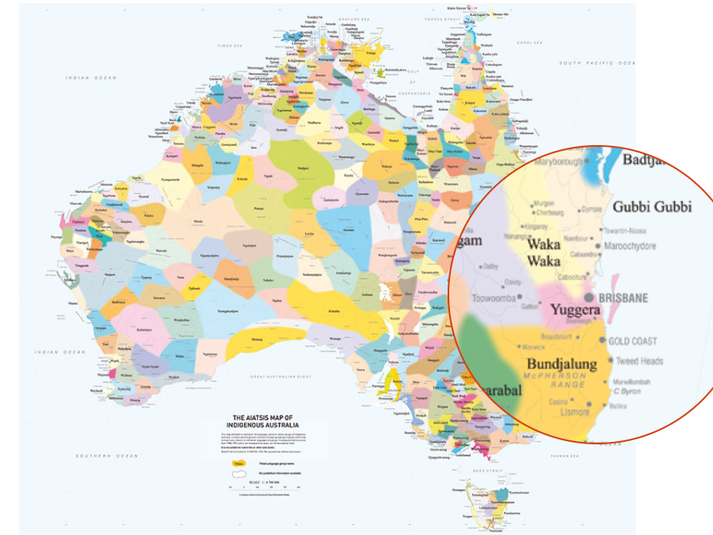
Land acknowledgement
Acknowledge Yuggera
as the traditional
owners of this land.

Slide 5
Access this information
Access this presentation and all links at pz.tt/mobile23

Slide 6
Meet our team

Slide 7
Disabilities
Dyslexia
Moderate vision impairment
Severe vision impairment
Epilepsy
Migraines
Physical impairment
Fibromyalgia
Multiple Sclerosis
Cohn's Disease
PTSD
Asperger's

Slide 8
It’s not just about vision impairments

Slide 9
About Gian
1998
Worked on first accessible website in Australia
Created Australia’s first automated accessibility testing tool
Invited Expert to W3C WCAG2 Working Group
Worked on Melbourne 2006 Commonwealth Games
Managed Usability and Accessibility Services at Monash University

Slide 10
About Gian, continued
Founded AccessibilityOz
Released OzPlayer
Released OzArt
Spoke at the United Nations
on web accessibility
Nominated for
Australian of the Year
Inducted into the Centre for Accessibility’s Hall of Fame as Accessibility Person of the Year 2019
2023

Slide 11
A little background…

Slide 12
Why did we develop this methodology?
Notes:
ICT Testing Symposium 2017 Town Hall

Slide 13
Introduction
ICT Accessibility Testing Symposium has developed a methodology for evaluating the accessibility of mobile web sites. This document is an amalgamation of accepted mobile accessibility testing standards from around the world, including additional developments from the ICT Accessibility Testing Symposium’s Mobile Sub-Committee.

Slide 14
Mobile accessibility features
Native screen readers
  TalkBack (Android)
  VoiceOver (iOS)
Volume control
Haptic keyboard
Visual, auditory and vibrational notifications
Screen rotation
Mono audio
Voice Control
Increase text and display size
Reduction of motion
Zoom
Reader view / Simplified view

Slide 15
What about WCAG2.1?

Slide 16
WCAG2
WCAG2 success criteria are applicable to mobile, however, not all aspects of mobile accessibility are specifically covered by WCAG2. For example, although WCAG2 requires sites to be accessible to the keyboard user, it does not specify that it should also be accessible to the touchscreen user.

Slide 17
WCAG2.1
WCAG2.1 builds on this and addresses more criteria related to touch screen (pointer gestures), sensors and small screen devices, however it still does not cover all user needs related to mobile accessibility.

Slide 18
Methodology errors note
Please note that this methodology does not include those errors already included in WCAG2 but does include those errors in WCAG2.1

Slide 19
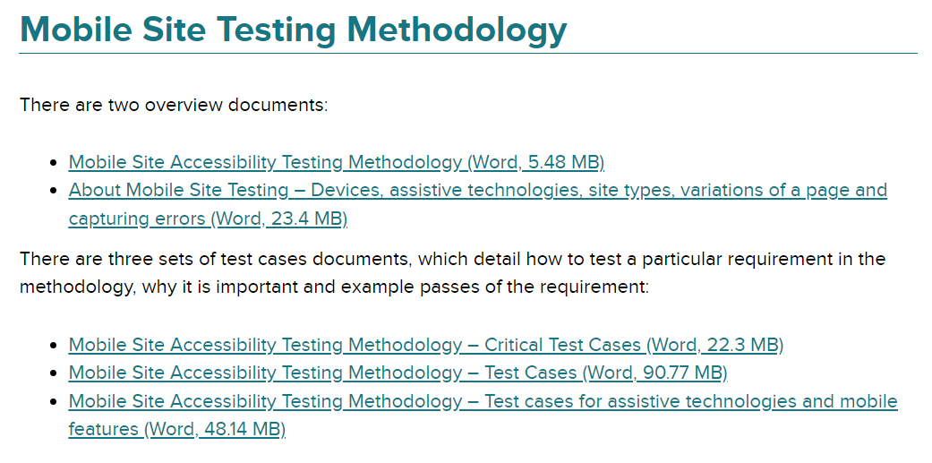
Where can you find these?
You can download the guidelines at
bit.ly/3AdDjjP

Slide 20
Mobile issues

Slide 21
Page variations
As part of WCAG2, zooming to 200% should already be included in regular testing (and therefore is not included in this methodology).
Low vision users (who use the zoom function inherent in the browser) are often restricted to a mobile view of the site on their desktop.

Slide 22
Therefore it is essential that functionality is not removed due to a variation in the page.

Slide 23
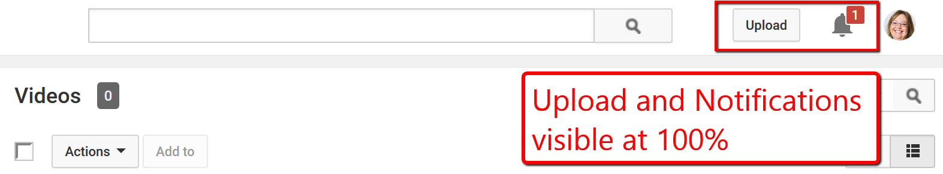
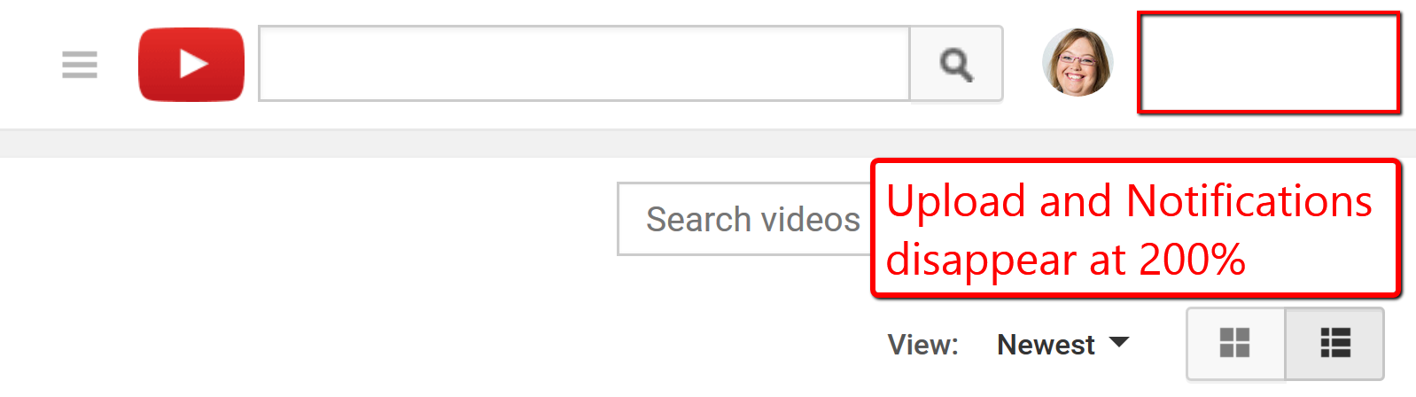
WCAG2.1 page variations
WCAG Conformance Requirement – Full Pages – Page variations

Slide 24
WCAG2.1 Accessibility Supported
    WCAG Conformance Requirement - Accessibility Support - Implementation techniques that supports Assistive technology used on mobile devices such as Talkback, VoiceOver, and switch control. (Also applicable to WCAG 2.0)
What does A11y Supported mean for mobile?
    Testing (especially Native Apps) with the following assistive technologies on mobile must be conducted

Slide 25
Android assistive technologies and features
TalkBack
Keyboard
Keyboard and switch
Magnification
Remove animations
Invert colours
Grayscale
Increase display size
Increase text size (with Chrome)
Simplified view (mobile sites only)

Slide 26
iPhone assistive technologies and features
VoiceOver
Keyboard
Keyboard and switch
Zoom
Reduce Motion
Invert colours
Grayscale
Reader view (mobile site only)

Slide 27
iPad assistive technologies and features
VoiceOver
Keyboard
Keyboard and switch
Zoom
Reduce Motion
Invert colours
Grayscale
Reader view (mobile site only)

Slide 28
Testing methods

Slide 29
Testing methods – Mobile Sites
There are four main testing methods in mobile testing:
    Devices: test on mobile and tablet devices
    Devices with assistive technology: test on mobile and tablet devices with assistive technologies
    Responsive Window: test on responsively sized window on desktop
    Desktop: test on desktop

Slide 30
Testing methods – Native App
There are two main testing methods in native app:
    Devices: test on mobile and tablet devices
    Devices with assistive technology: test on mobile and tablet devices with assistive technologies

Slide 31
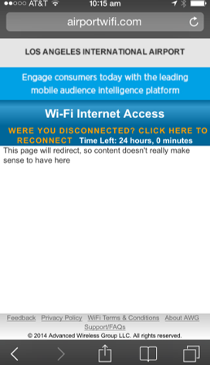
Test with real devices
I don’t feel safe giving you my contact details…

Slide 32
Mobile Site & Native App Testing Methodologies

Slide 33
Mobile Site Testing Methodology Overview
Step 1: Identify devices
Step 2: Identify site type and variations
Step 3: Test critical issues
Step 4: Test mobile-specific issues
Step 5: Test mobile assistive technology and feature support

Slide 34
Native App Testing Methodology Overview
Step 1: Identify devices
Step 2: Define application functionality
Step 3: Test critical issues
Step 4: Test mobile-specific issues
Step 5: Test mobile assistive technology and feature support

Slide 35
1. Identify devices

Slide 36
Determining which devices to test on
    In the United States, Australia, and other western countries, iOS devices are most popular. In Asia and other eastern countries, Android devices are most popular. To best find which devices to test on, review the Google Analytics or other analytics system for the requisite web site.

Slide 37
Choosing devices
    Due to the popularity of the Android system, there are tens of thousands of Android operating systems and browser combinations available. It is not possible to test on all these systems.
    The “Internet” browser that comes pre-packaged with most Samsung phones is very dependent on the operating system itself and it is a better representation to test with Chrome.

Slide 38
Devices with assistive technologies
    Even if the site is a desktop site, people will still use the site on mobile.

Slide 39
Devices with assistive technologies
    It is important to remember that even assistive technologies that work across desktop and devices may behave differently on each system, and therefore they still need to be tested on mobile and tablet devices.
    For the latest information on screen reader usage, please see the WebAIM Screen Reader Survey.

Slide 40
Additional device screen readers
    Samsung includes an additional screen reader called “Voice Assistant,” however TalkBack is still available as part of the Accessibility Suite. Amazon Fire also utilizes a different screen reader called “Voice View”.

Slide 41
Identify devices
Recommended devices and browser combinations:
iPhone, (Safari)
iPad, (Safari)
Android phone, (Chrome)

Slide 42
Identify devices
Other devices to consider
Android tablet, Chrome
Alternative devices such as a Kindle device

Slide 43
Identify devices
Test on the latest version of iOS and iPadOS.
Test on latest two versions of Android.
When a site is directly aimed at people with a particular kind of disability, consider including assistive devices and/or other assistive technologies used by potential users.

Slide 44
WCAG and this methodology
You need to meet WCAG2 and this mobile testing methodology

Slide 45
2. Identify site type & variations of the page

Slide 46
Identify site type and variations
Is the site:
Desktop
M.dot
Responsive
If the site is responsive, are there variations of the page?

Slide 47
Three types of mobile sites
    Desktop web sites: that have only one display, whether viewed on desktop or mobile or tablet device
    m.dot sites: that have a particular display for mobile and tablet sites. The m.dot site must also be tested against the entirety of WCAG2, in addition to the standard www version of the site.
    Responsive web sites: that change depending on the screen size or other feature as determined by the developer

Slide 48
2. Define application functionality

Slide 49
Define application functionality
Through your understanding of the purpose of the native app, define which functionality is critical to its purpose and use and that must be tested for efficacy, operability, and workflow from a user experience perspective.

Slide 50
Define application functionality
    Ask the question: how would the experience be impacted if the functionality failed, the content could not be reached, and or the experience caused a barrier to the user?
    Prioritise. All functionality should be accessible within the native app; however, it is important to define and include the critical functionality for each individual app to be prioritised in your testing.

Slide 51
Common elements to test
Navigation
Landing screen(s)
Emergency sections
Login flows
Settings
Account and profile
Contact Us
Real-time updates
Privacy policy, Terms and Conditions
Interactional functionality
Help section
Widgets (calendars, etc)
Geo-locational maps
High-traffic areas

Slide 52
Find these guidelines
Find these methodologies on the AccessibilityOz web site under the Resources menu item

Slide 53
3. Test critical issues

Slide 54
New features means new traps
Trap: Where a user is trapped within a component and cannot escape without closing the browser or app.
There are many more traps in mobile sites and native apps than on desktop.

Slide 55
Traps identified
Exit trap
Swipe / Scroll trap
Text-to-speech trap
Headset trap
Layer trap

Slide 56
Exit trap
Ensure there is always an accessible actionable item (e.g. a close button that meets color contrast requirements and has an accessible name) that closes any feature that overlays the current page (such as a full-page ad).
Applies to: All users
Methodology: Mobile Site and Native App

Slide 57

Exit trap
No way to close the feature (usually an ad)

Slide 58
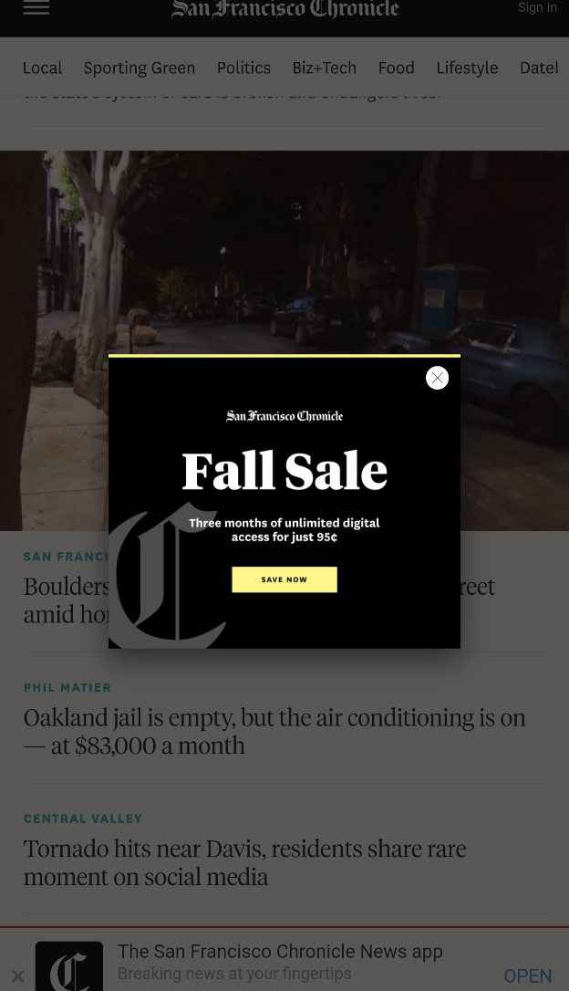
Exit trap
Close button does not meet color contrast or touch target size requirements

Slide 59
Swipe / Scroll trap
Ensure you do not override standard mobile touch functions (swiping, scrolling, etc.) on the majority of the page.
Applies to: Touch users
Methodology: Mobile Site and Native App

Slide 60
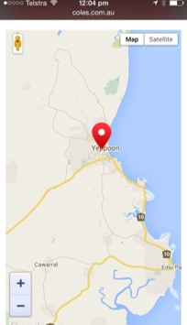
Swipe / Scroll trap
The zoom of doom

Slide 61
Text-to-speech trap
If the app has an ability to provide content via text-to-speech, the screen reader user must be able to pause or stop the app speaking in a simple manner, e.g. by performing a swipe on a screen.
Applies to: Screen reader users
Methodology: Native App

Slide 62
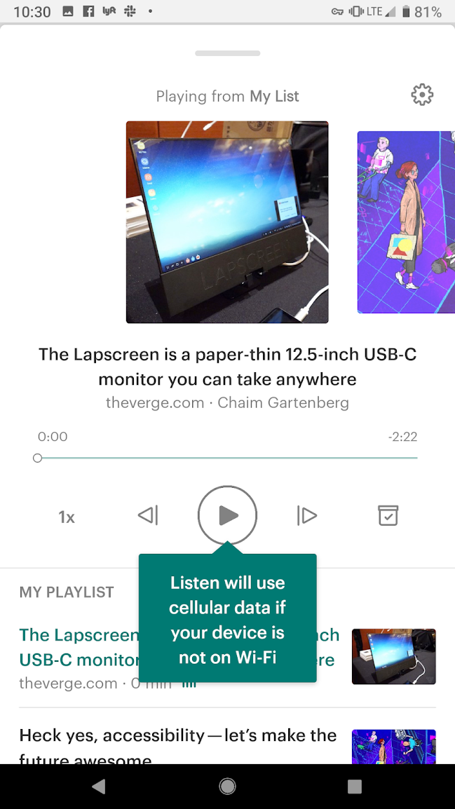
Text-to-speech trap
Once activated, screen reader users cannot stop the TTS

Slide 63
Headset trap
Headset users must always be able to pause media (audio or video) content by using the Pause/Play control on the headset.
Applies to: Screen reader users, Headset users
Methodology: Mobile Site and Native App

Slide 64
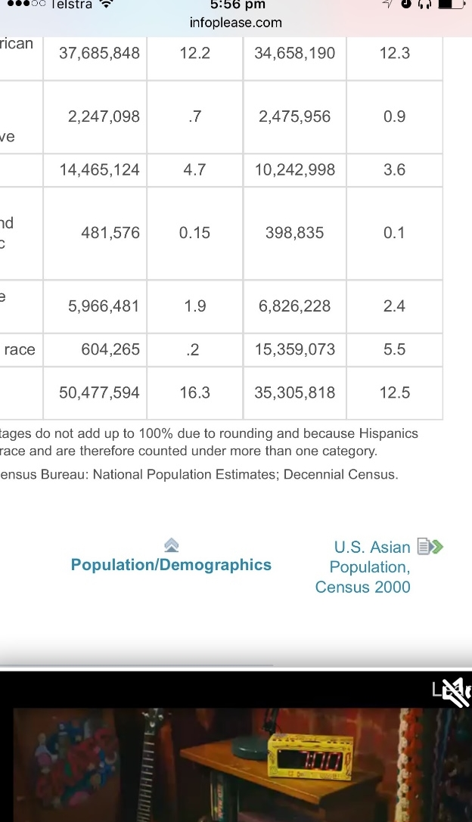
Headset trap
Cannot pause the audio using headset hardware (pause on the headset pauses the screen reader)

Slide 65
Layer trap
The user should not be trapped on a non-visible layer.
Applies to: All users (but mostly encountered by screen reader users and sometimes keyboard users)
Methodology: Mobile Site and Native App

Slide 66
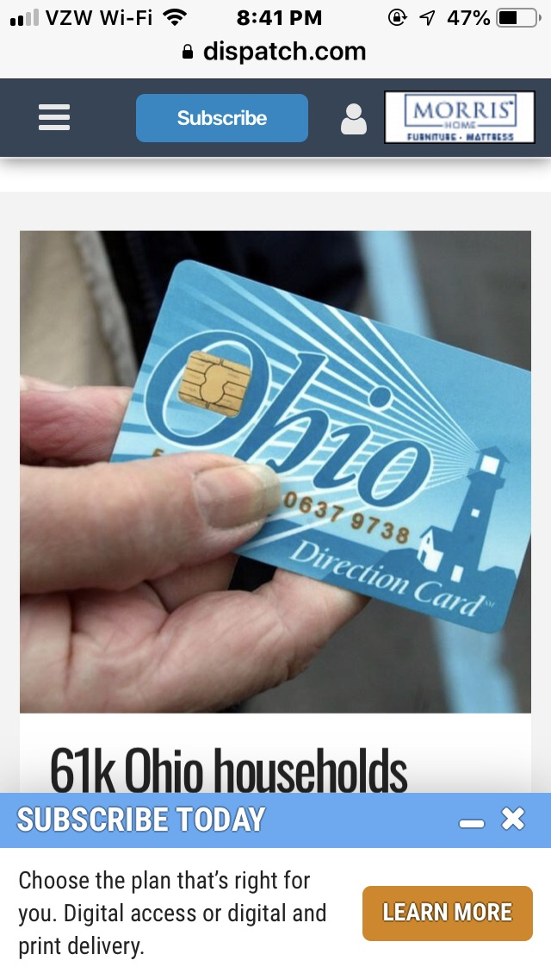
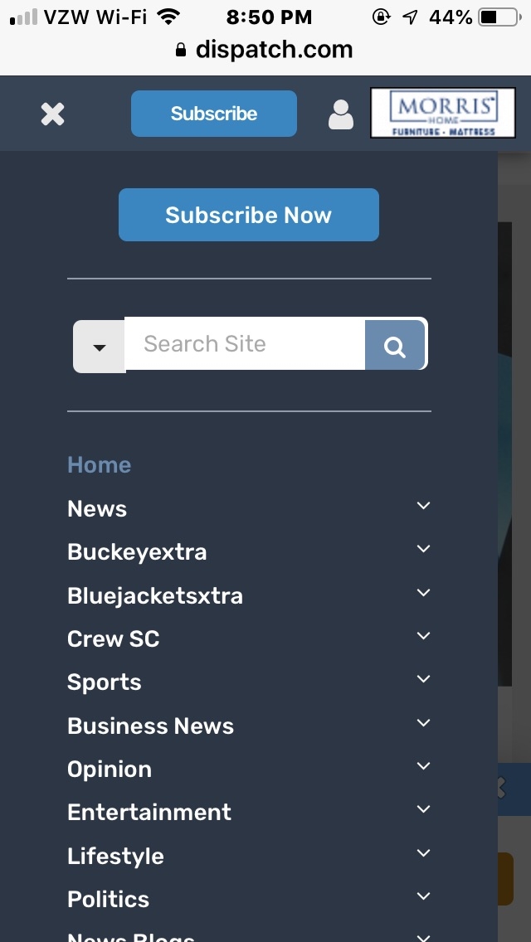
Layer trap
Screen reader user cannot access the menu. Focus stays on the parent layer.

Slide 67
4. Test mobile-specific issues

Slide 68
Alternatives

Slide 69
Alternatives
2.1: Motion, interaction and gesture
2.2: Touch gestures
2.3: Geolocation
2.4: Change of state
2.5: Audio cues
2.6: Status messages
2.7: Abbreviations
2.8: Summary of content
2.9: Ambiguous text

Slide 70
Let’s see an example from the document

Slide 71
Touch gestures
Any touch gesture must have an alternative, accessible, actionable item (for more information see SC 2.5.1: Pointer Gestures).

Slide 72
Examples of touch gestures
Swiping up and down or left and right
Dragging up and down or left and right
Double-tapping
Tap and hold
Tap and swipe
Two pinch zoom
Press and long hold

Slide 73
Examples of alternative, accessible gestures:
A link
A button
A dropdown
A separate page with the same functionality

Slide 74
About this requirement
This requirement is particularly important for screen reader users. For example, if you require your user to swipe right to complete a purchase, when the screen reader is on, the swipe right gesture moves you to the next focusable item and doesn’t complete the purchase. You must be able to perform the same action, by using a link, an up or down swipe, or some other gesture.

Slide 75
About this requirement
Please note that this requirement is similar to the Exit Trap requirement. A failure of the Exit Trap requirement is that a user cannot escape from content or a page. A failure of the Touch Gestures requirement is that the user cannot choose content or a page (i.e. they are not trapped).

Slide 76
How to test
Identify any site controls. If they require any of the following gestures, is there an accessible actionable item provided as an alternative?
Swiping up and down or left and right or dragging up and down or left and right
Double-tapping or two-pinch zoom
Tap and hold or tap and swipe
Press and long hold

Slide 77
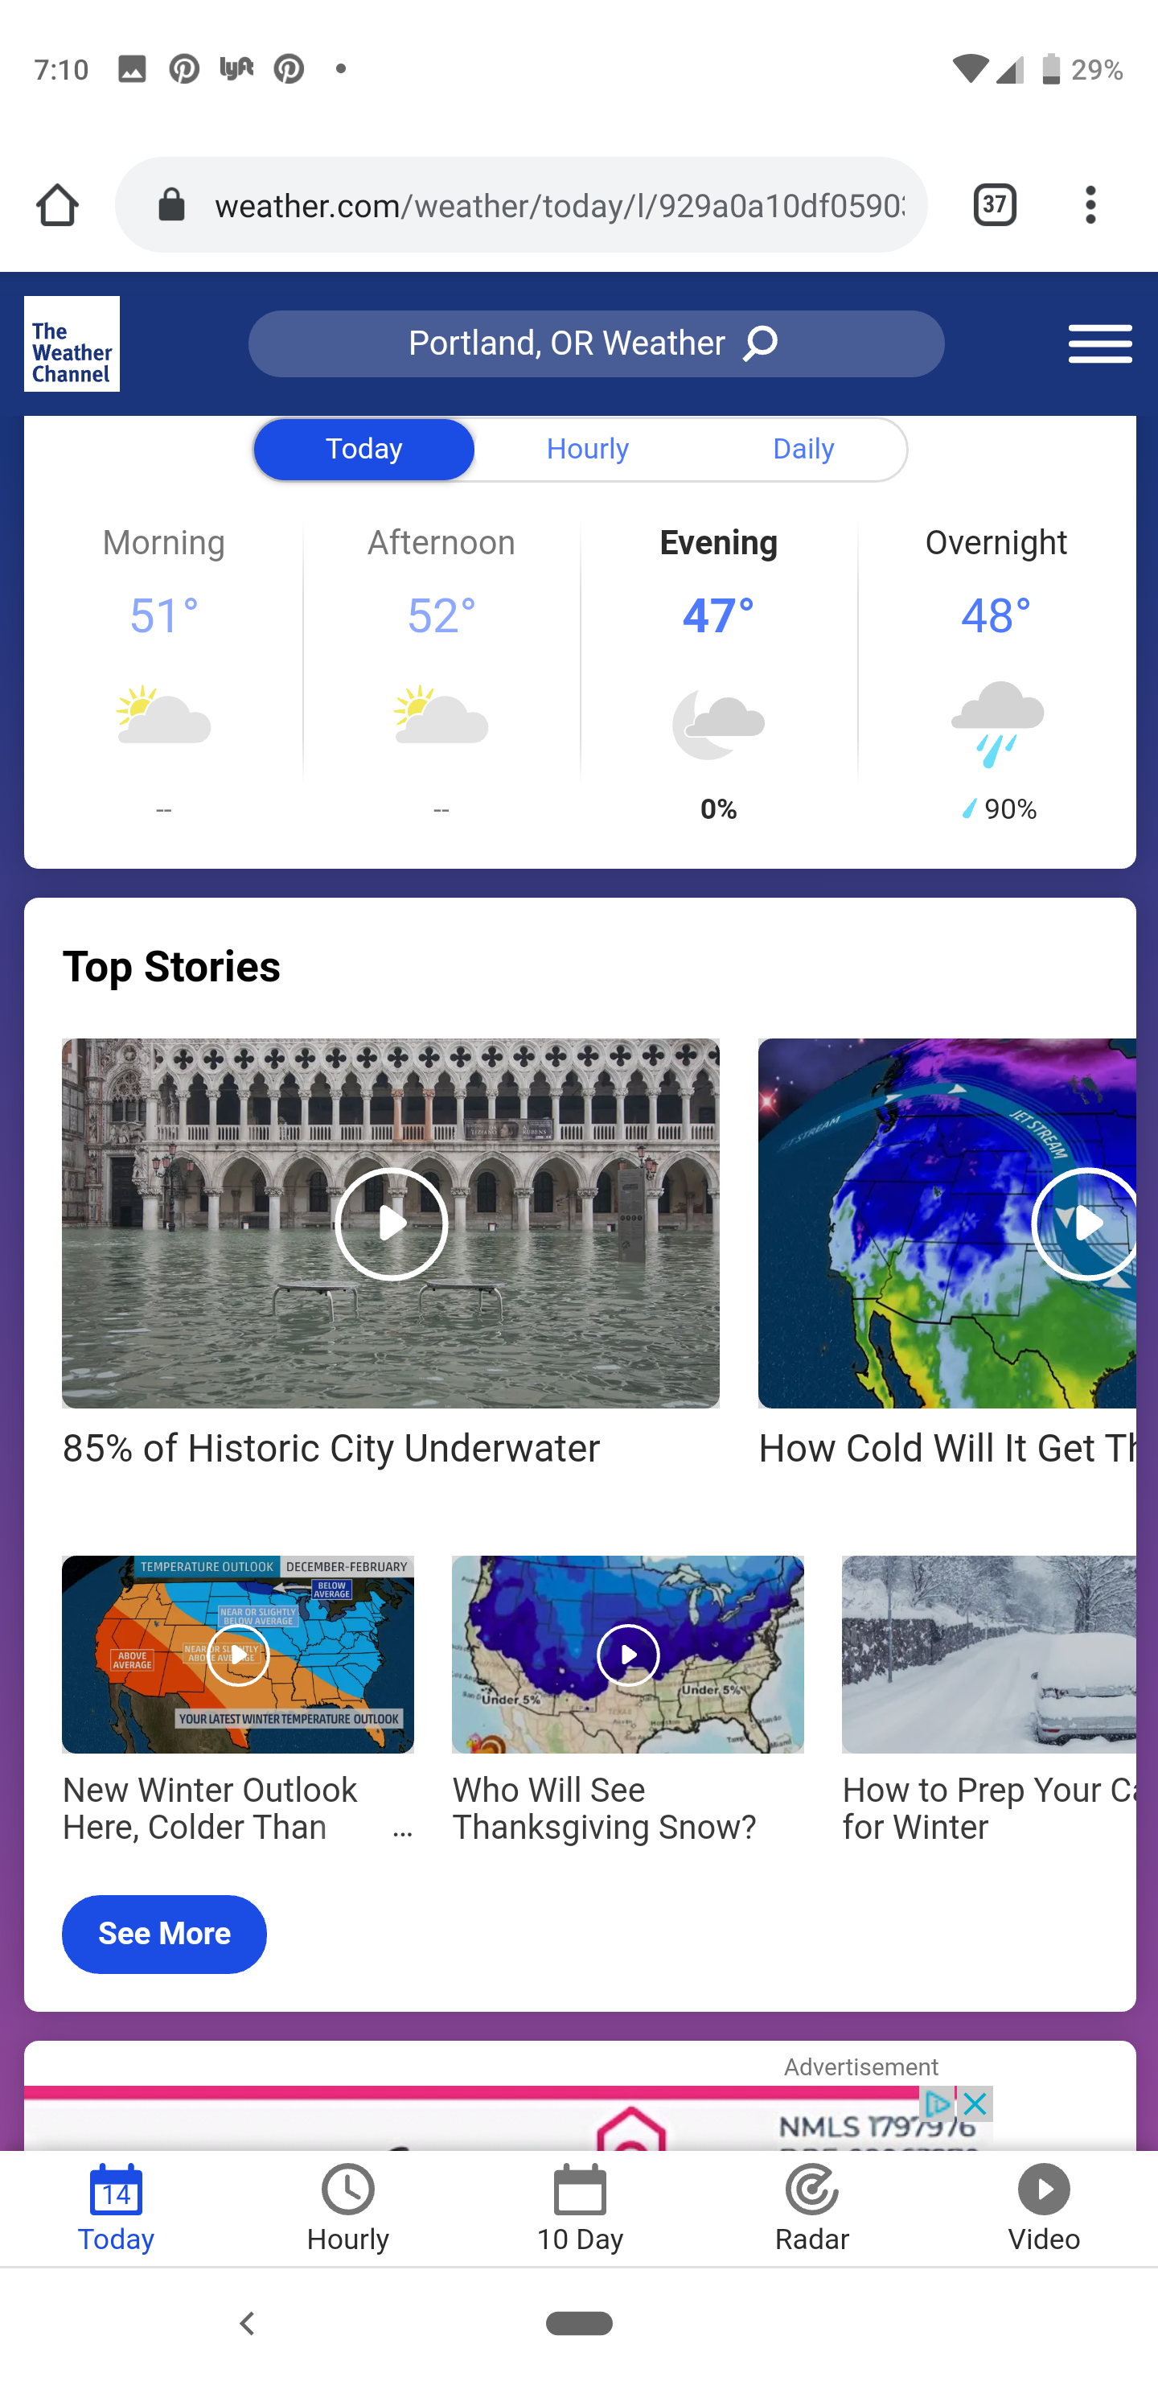
Pass Example
Alternative is provided on another page
Notes:
Two rows of content under the “Top Stories” heading indicate that more content is visible on swipe as part of the content is cut off. There is a link labelled “See more” and the same content is shown when this link is activated as the additional content on swipe.

Slide 78
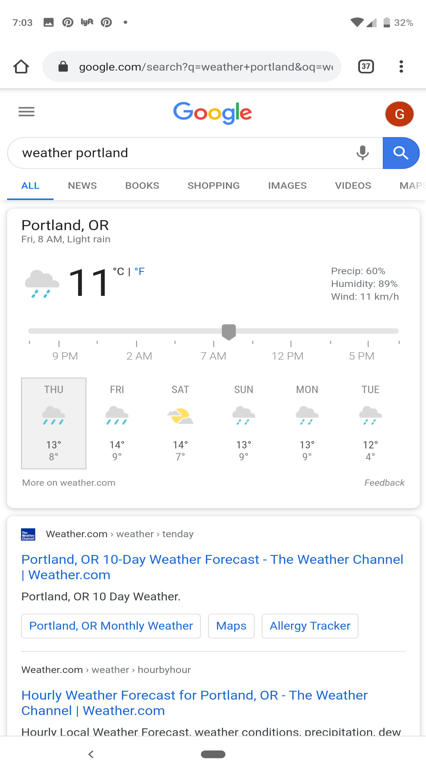
Pass Example
Tap alternative is provided instead of drag gesture
Notes:
When viewing the weather on Google you can select and drag the slider to determine the weather at certain times during the day. You can also tap on one of the times to move the slider to that specific time.

Slide 79
Display

Slide 80
Display
3.1: Three flashes
3.2: Change on request
3.3: Target size
3.4: Inactive space
3.5: Fixed size containers
3.6: Justified text
3.7: Colour contrast
3.8: Orientation
3.9: Animation

Slide 81
3.3: Target size
Size of touch targets is at least 44 by 44 CSS pixels (approximately 7 to 10 millimeters). For more information see WCAG2.1 SC 2.5.5: Target Size. Please note that this differs from WCAG2.1 as SC 2.5.5 is a Level AAA requirement, but in this methodology, it is a mandatory requirement.
Notes:
About this requirement
Most people use touch as the form of interaction on mobile and tablet devices. Touch is not as granular as mouse interaction and can depend on the size of a person’s fingers. People with certain physical disabilities may find it difficult to activate very small touch targets.
This requirement is the same as SC 2.5.5: Target Size, however the following exclusions are not allowed:
Equivalent: the target is available through an equivalent link or control on the same page that is at least 44 by 44 CSS pixels; and
Inline: the target is not text within a sentence or block of text
We allow for words not to meet Touch Target Size requirements, but non-word content must meet this requirement. For example, a link “learn more about us” does not need to meet the requirement, however a footnote or icon, such as “learn more about us ” does need to meet this requirement. This is because text on mobile devices can be easily increased in size, whereas icons are more difficult to change.
The committee believes the term “block of text” means text within a sentence of sentence fragment. A block of text is not a set of links, such as a navigation or footer. Although this text will respond to increase text size features within the mobile device, they are often restricted to fixed size containers and may not resize appropriately.
Exclusions
This requirement allows for two exceptions:
Inline: the target is text within a sentence or block of text
User agent control: the size of the target is determined by the user agent and is not modified by the author; or
Essential: a particular presentation of the target is essential to the information being conveyed
How to test
Identify all actionable touch targets. Turn on screen reader.
Swipe to each actionable touch target.
Measure the size of the actionable touch target.

Slide 82
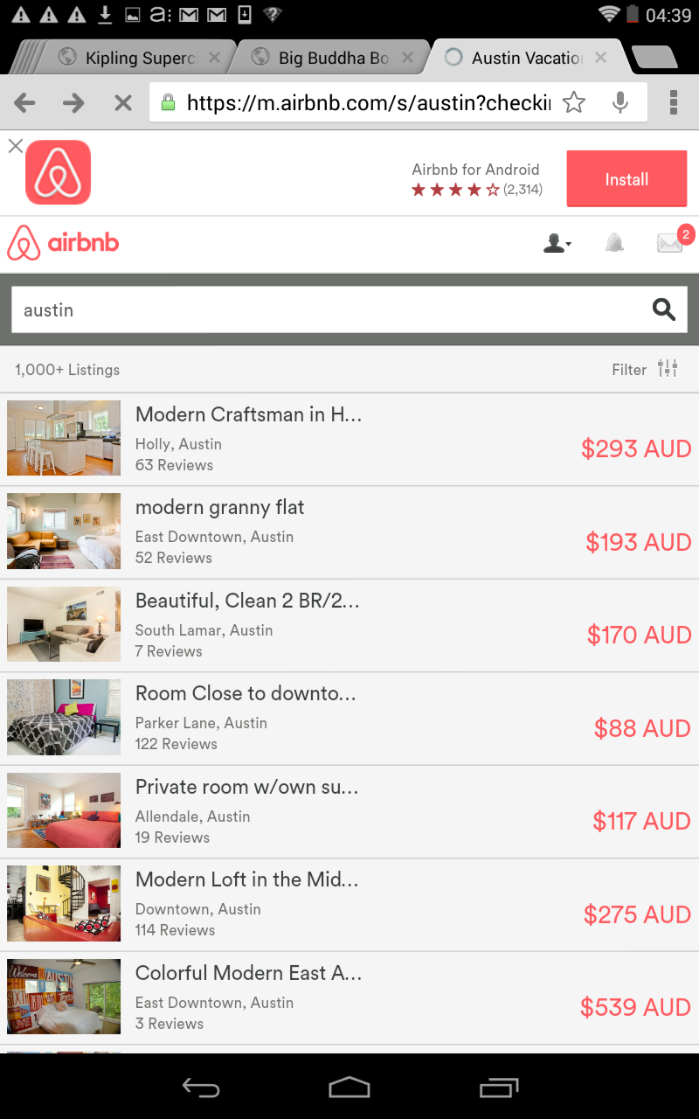
2.5.5 example
Fail – Touch target size is not sufficient
Notes:
When visiting the AirBNB website, a popup occurs at the top asking if you would like to install the AirBNB native app. The only way to close this popup is to activate the small close item in the top left corner. This close item is very small and does not meet touch target size requirements.
Please note that this is not an Exit Trap as the popup does not overlay the page.

Slide 83
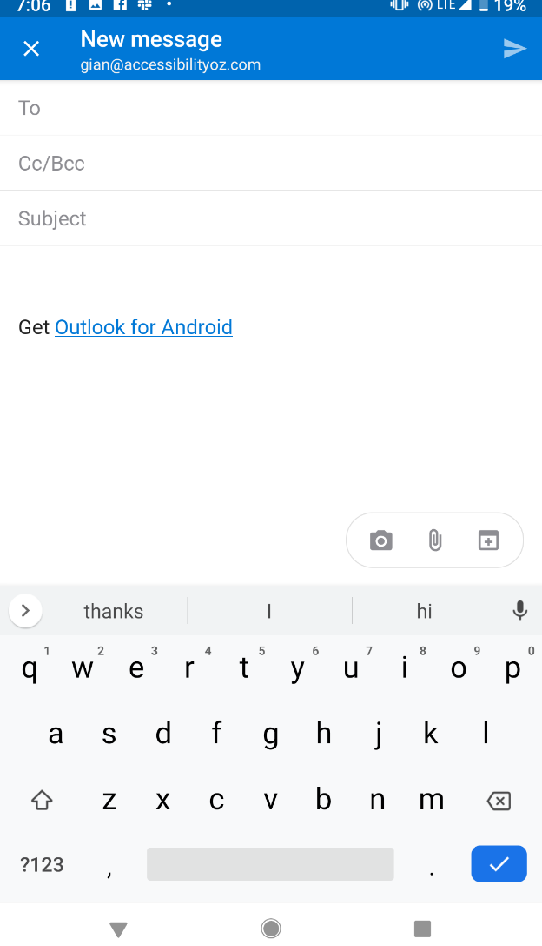
2.5.5 example
Pass – Touch target size is sufficient
Notes:
In Outlook, the To, CC, BCC and Subject fields are appropriately spaced out.

Slide 84
3.4: Inactive space
Actionable items have sufficient inactive space between them (Inactive space of at least 10 pixels should be provided around active elements).
Notes:
About this requirement
Most people use touch as the form of interaction on mobile and tablet devices. Touch is not as granular as mouse interaction and can depend on the size of a person’s fingers. People with certain physical disabilities may find it difficult to activate the correct item if multiple options are available without a minimum of inactive space.
Exclusions
This requirement allows for two exceptions:
User agent control: the size of the target is determined by the user agent and is not modified by the author; or
Essential: a particular presentation of the target is essential to the information being conveyed
How to test
Identify all adjacent touch targets. Turn on screen reader.
Swipe to each actionable touch target.
Measure the distance between them.

Slide 85
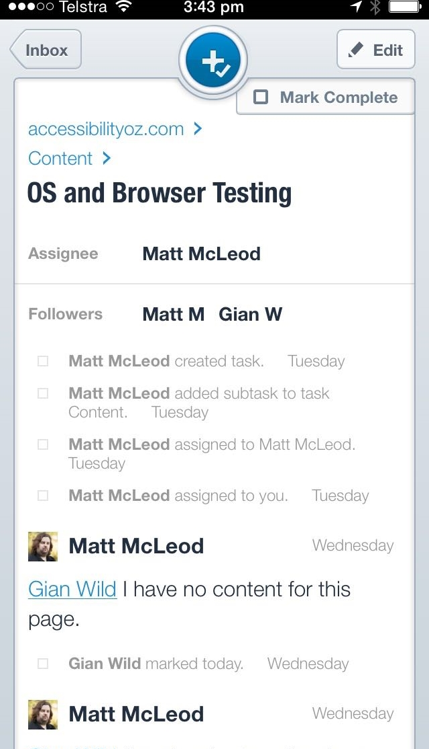
Spacing
Fail – Be careful what you select…
Notes:
In the Asana app, there is insufficient space between the Edit and the Mark Complete buttons in the top right-hand corner.

Slide 86
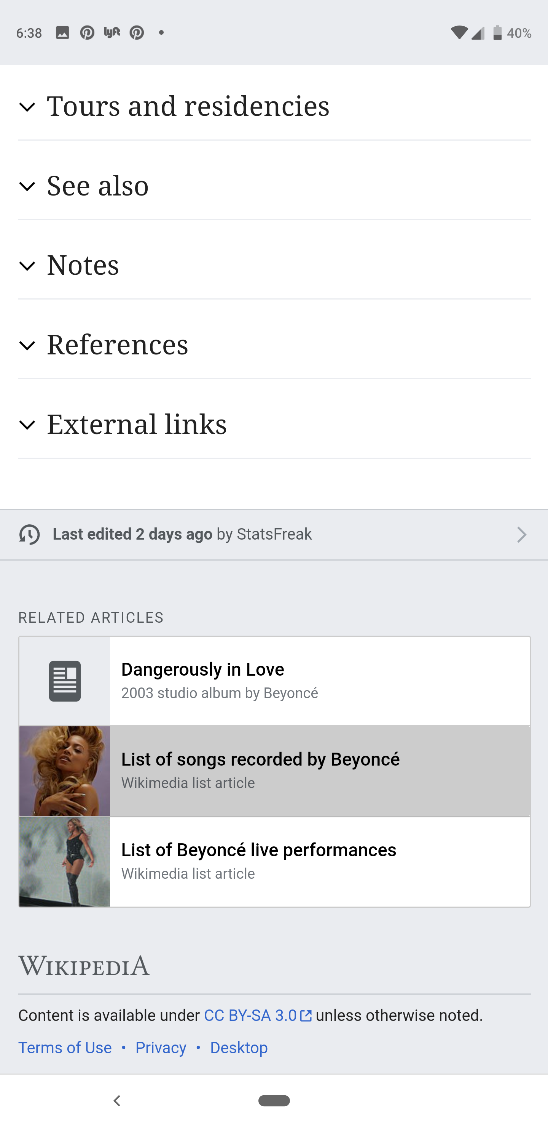
3.4: Inactive space
Fail – No inactive space
Notes:
In this example there is no inactive space between the links, other than a light gray border.

Slide 87
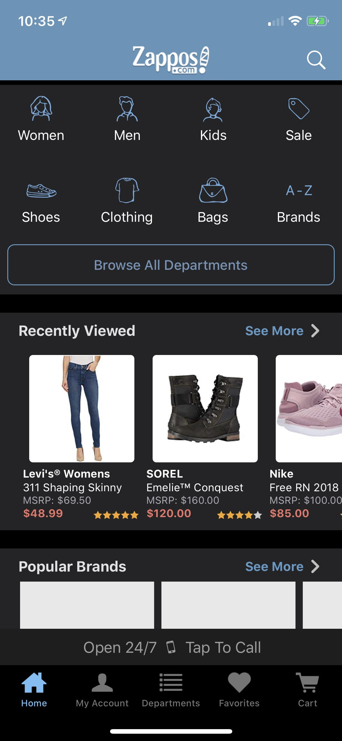
3.4: Inactive space
Pass – Sufficient inactive space
Notes:
Controls have at least 2.5 mm between them

Slide 88
Actionable items

Slide 89
Actionable items
4.1: Content on hover, focus or input
4.2: Native UI
4.3: Descriptive text links
4.4: Non-keyboard options
4.5: Infinite scrolling
4.6: Colour alone
4.7: Removal of touch

Slide 90
4.6: Colour alone
Colour alone should not be used to indicate actionable items (if not underlined). A secondary method, such as underline or bold should be used, in addition to colour.
Notes:
About this requirement
This technique is aimed at visual users only. Although this requirement relies heavily on WCAG2.1 SC 1.4.1: Use of Color, this success criterion allows exceptions for actionable items that differ from text in colour alone if that difference meets colour contrast requirements of a 3:1 ratio. Mobile devices are, by nature, mobile and used in a variety of environments, including full sun and full darkness. This means that colour differences that may be obvious to all users in an office environment could be unclear in other locations.
In addition to this, actionable items on desktops provide feedback to the user when the user mouses over (at the minimum the cursor changes icon) them or tabs to them (at the minimum the address of the actionable item is displayed at the bottom of the screen). In WCAG2 there are requirements to ensure that these focus indicators are clear to all users. Mobile devices do not provide this kind of feedback by default, so an important aspect of indicating actionable items is lost. Thus, this committee believes colour alone is not sufficient to indicate actionable items.
Exclusions
This committee believes that exceptions exist for links that are not inline text. This includes items in a navigation bar, button text (although these do need to meet colour contrast requirements they do not need to meet this requirement) as there is enough visual information to separate these actionable items from text.
How to test
Identify all actionable items.
Verify that colour alone is not used to differentiate actionable items from non-actionable items.

Slide 91
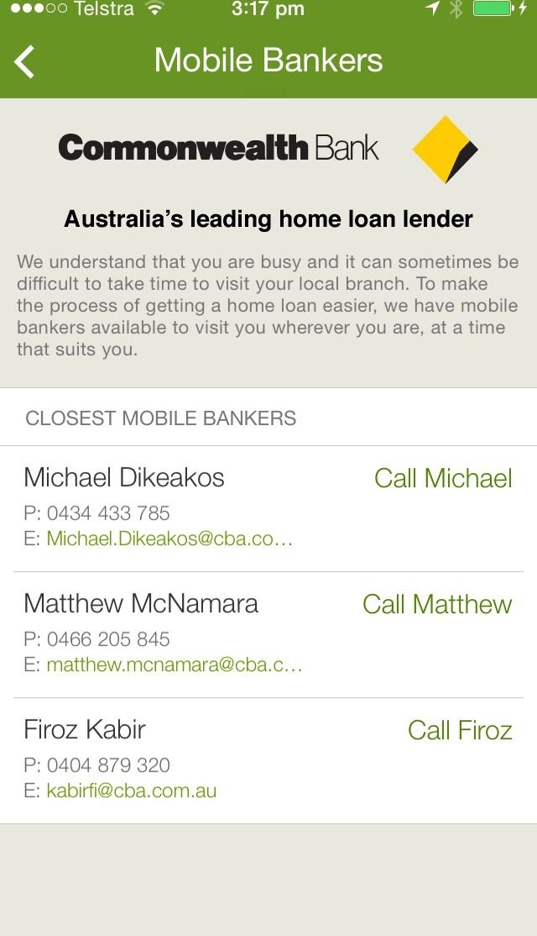
Functionality unclear
Fail – Ah, the green are links… Or are they…?
Notes:
Some text is in black and some is in green. Links are also in green. It is not possible to visually determine what is text and what is a link.

Slide 92
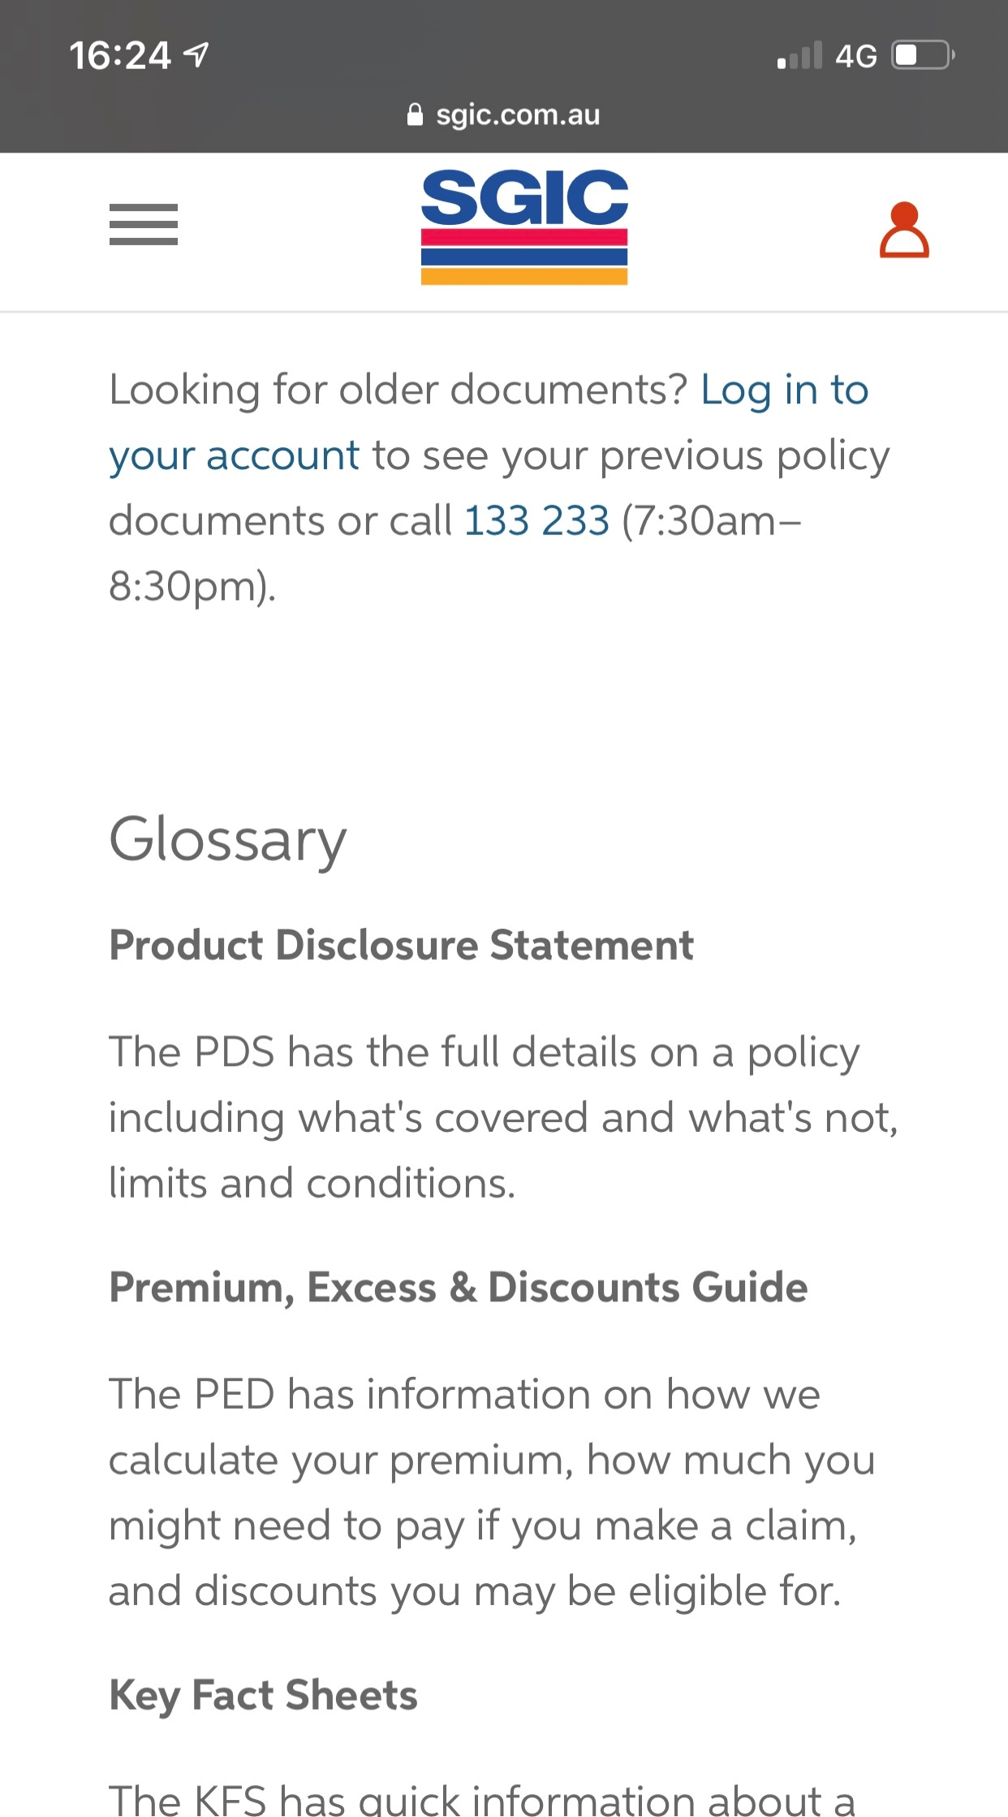
Non-underlined links
Fail – Colour alone
Notes:
Text is black and links are blue.

Slide 93
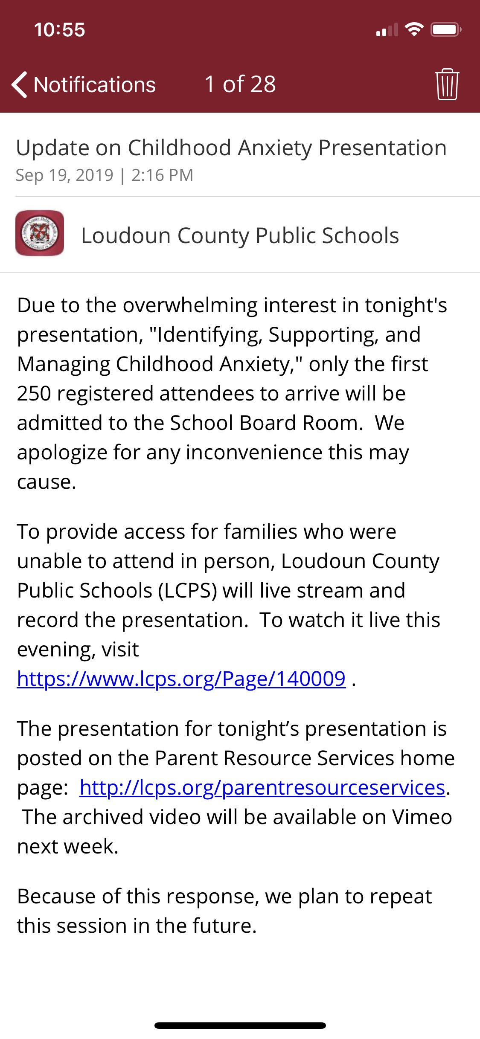
4.6: Colour alone
Pass – Link text is indicated with colour and an underline
Notes:
Links are differentiated from text with a colour change and an underline.

Slide 94
Navigational aids

Slide 95
Navigational aids
5.1: Visual indicators
5.2: Character key shortcuts
5.3: Descriptive headings
5.4: Inactivity timeout
5.5: Navigation features

Slide 96
5.1: Visual indicators
Visual indicators, (such as arrows, next and previous buttons) have been used to indicate swipe or scroll areas or additional functionality (for more information see WCAG2.1 SC 2.5.1: Pointer Gestures).
Notes:
About this requirement
When using a mobile device there is less feedback presented to the user as to the functionality available. For example, on a desktop or laptop when the mouse hovers over an actionable item the cursor changes. This does not occur on mobile devices as mobiles are reliant on touch and not mouse movement. As a result it is important to appropriately indicate additional content or functionality so users are aware of them.
How to test
Identify all areas of the app where additional content or functionality is added.
Is there a visual indicator that indicates that swipe will show additional content?
Does this visual indicator meet colour contrast, touch target size and inactive space requirements?

Slide 97
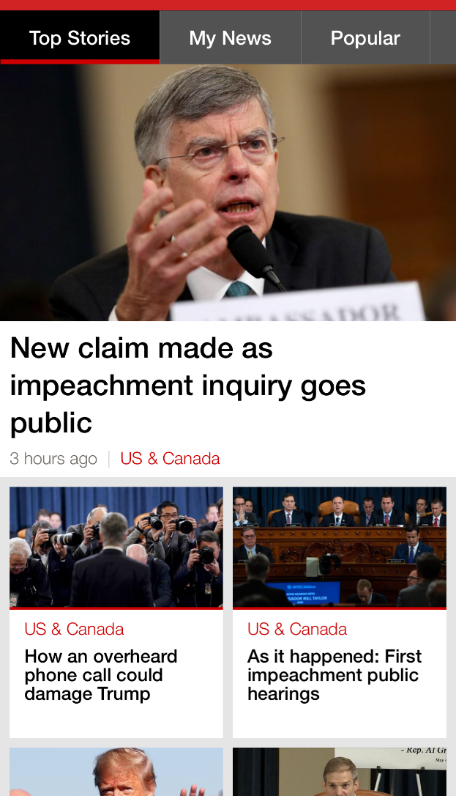
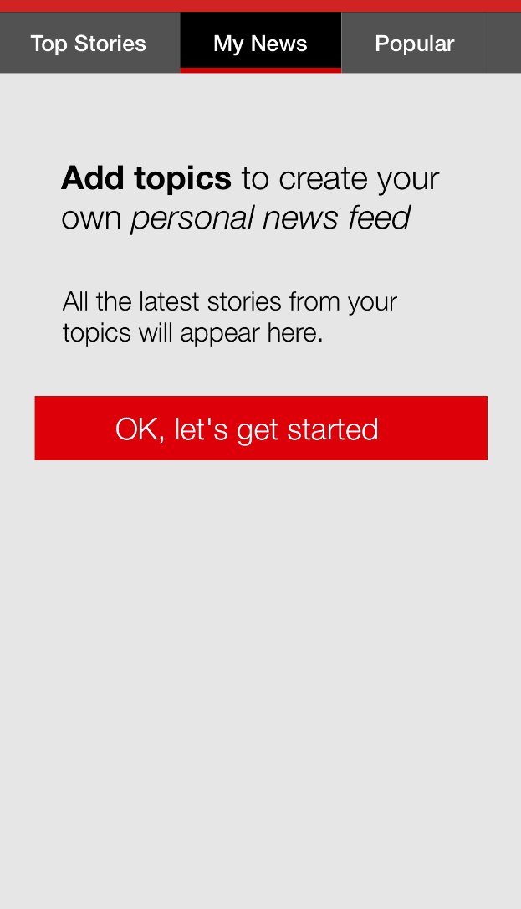
5.1: Visual indicators
Fail – No indicator of horizonal swipe
Notes:
Swiping from left to right moves to the next tab (from Top Stories to My News). This is not visually indicated anywhere on the page.

Slide 98
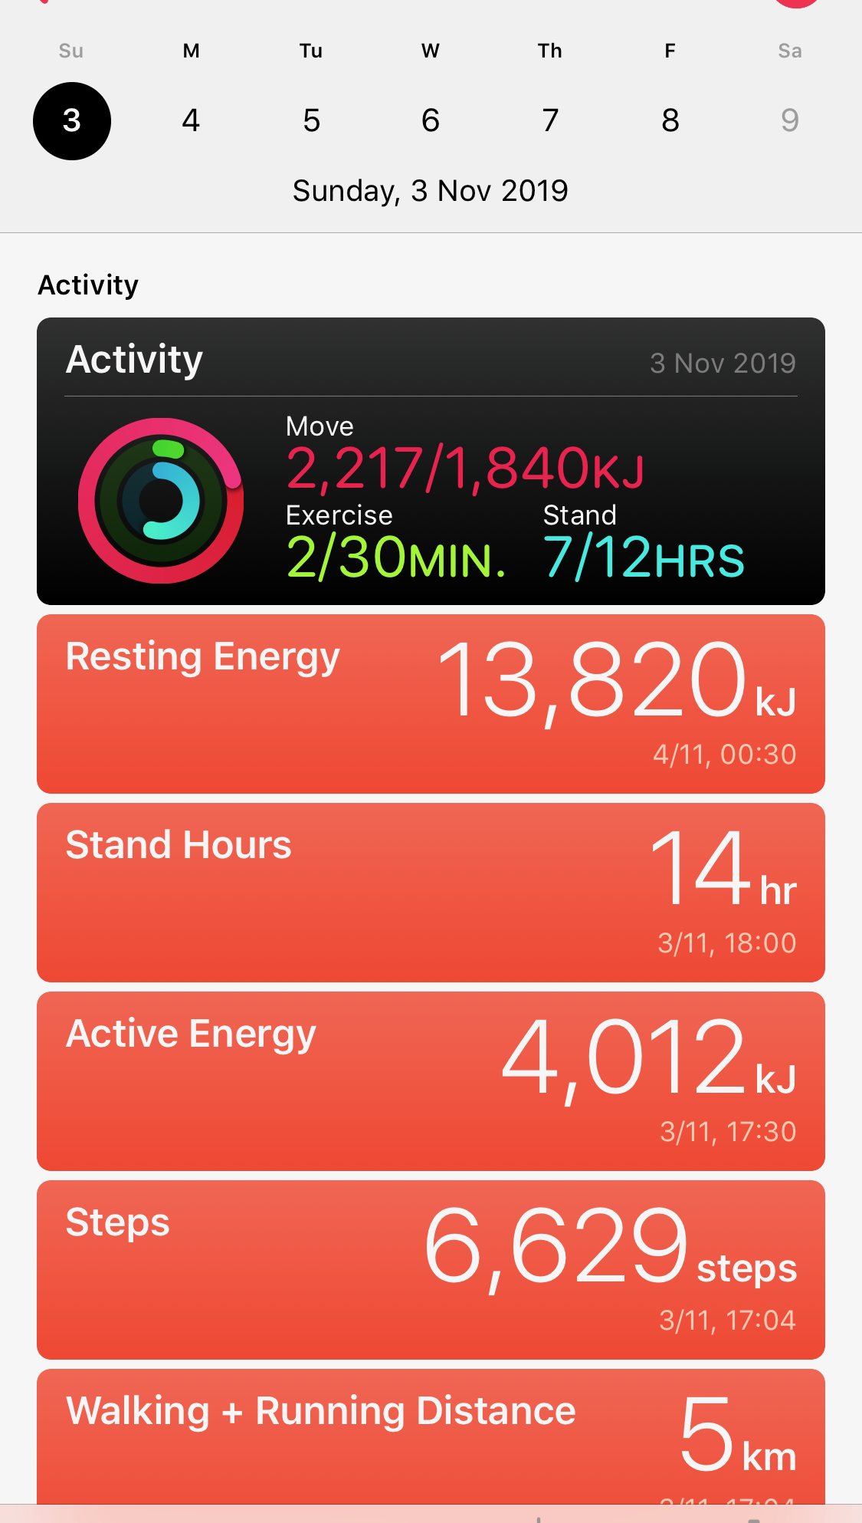
5.1: Visual indicators
Fail – Swipe to move to next week
Notes:
When on a particular week, you can swipe to the left or right to move between weeks. This does not have a visual indicator.

Slide 99
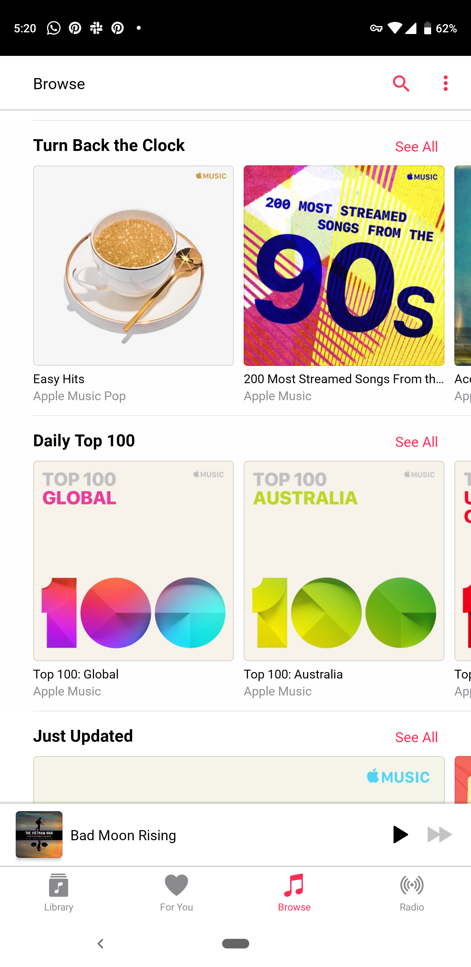
5.1: Visual indicators
Pass – Visual indicator of horizontal swipe
Notes:
Two album covers and a small portion of a third album cover is visible on the page. The fact that the majority of the third album is cut off, indicates that swipe can move through additional albums.

Slide 100
Audio and video

Slide 101
Audio and video
6.1: Transcript
6.2: Captions
6.3: Live audio and video

Slide 102
6.1: Transcript
All video and audio have an accessible transcript.
Notes:
About this requirement
Although captions are essential to people who are Deaf or hard of hearing and audio descriptions are essential for people with vision impairments, there are users that either cannot interpret these features or are Deaf-Blind. In this case, the only accessible method is to provide a transcript. Please note that the transcript must include both the audio and visual content in the video. It is not sufficient to have a transcript of only speech.
How to test
Open the application.
Navigate to the page(s) that contains – or launches – the video or audio player or file link.
Ensure that there is a textual transcript alternative available on the same page as the video or audio player.
Ideally it is adjacent to the video or audio player, with easy access.
The transcript may be in the form of text on a separate page in the application, or available as a download, or is available on a web page that is launched from the native app.
Access and read the transcript to ensure the textual transcript accurately reflects the content of the video or audio file.
Ensure the transcript is perceivable and operable using the built-in screen reader feature on mobile, whether on a page, webpage or PDF.
Ensure that any links to the transcript, or a title for the transcript document, is descriptive and clearly identifies the transcript as the content.

Slide 103
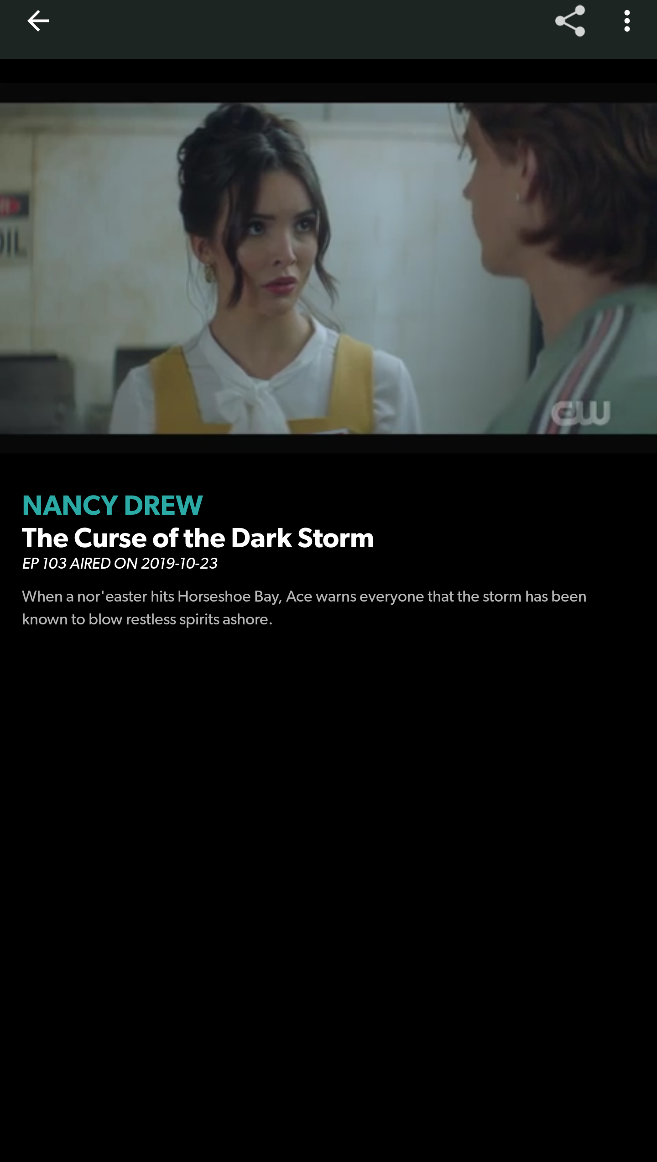
6.1: Transcript
Fail – There is no text transcript alternative to the video or audio file
Notes:
In the CW app, you can watch episodes of different television shows. The episodes do not have a transcript.

Slide 104
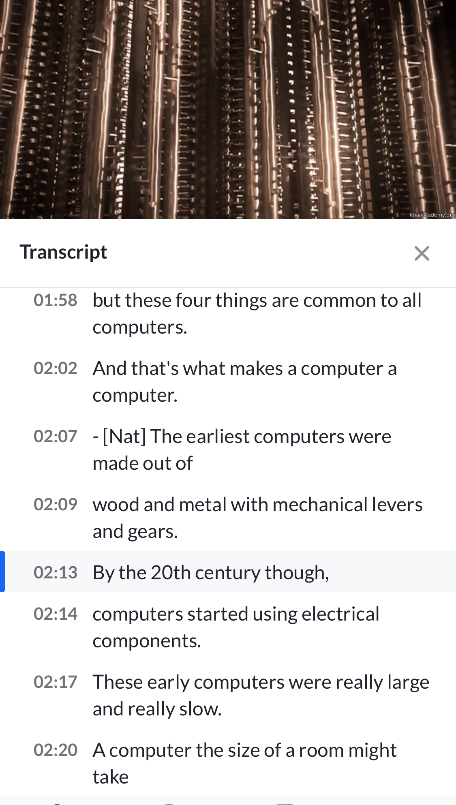
6.1: Transcript
Fail – The transcript is a direct transcription of the captions only
Notes:
In this example the transcript does not include descriptions of the visuals.

Slide 105
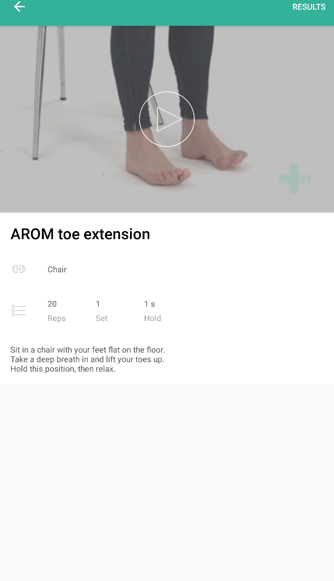
6.1: Transcript
Pass – Transcript is available and accurate
Notes:
A video showing the exercise is accompanied with a text transcript that accurately describes the entire video.

Slide 106
Forms

Slide 107
Forms
7.1: CAPTCHAs
7.2: Context-sensitive help
7.3: Error prevention
7.4: Positioned field labels
7.5: Visible field labels
7.6: Accessible name
7.7: Form and keyboard interaction

Slide 108
7.4: Positioned field labels
Field labels are positioned adjacent to their input field and appear closest to their respective input field in relation to other field labels and other input fields.
Notes:
About this requirement
As a mobile device has a small screen, if field labels are positioned far away from their respective input fields it is possible that they will not appear on the screen at the same time as the field that they describe. In addition, where a field label is positioned close to other input fields it may be unclear to some users which field the field label describes.
How to test
Review the application for form fields
Ensure that all form fields have adjacent field labels
When two or more form fields appear on the same screen, ensure that field labels appear adjacent to their respective form fields and are placed closest to their form field than other form fields
Ensure that field label spacing and layout is consistent between like form fields on the same screen.
Ensure that all form fields and field labels maintain accessible colour contrast ratios in all states (e.g. selected/not selected)

Slide 109
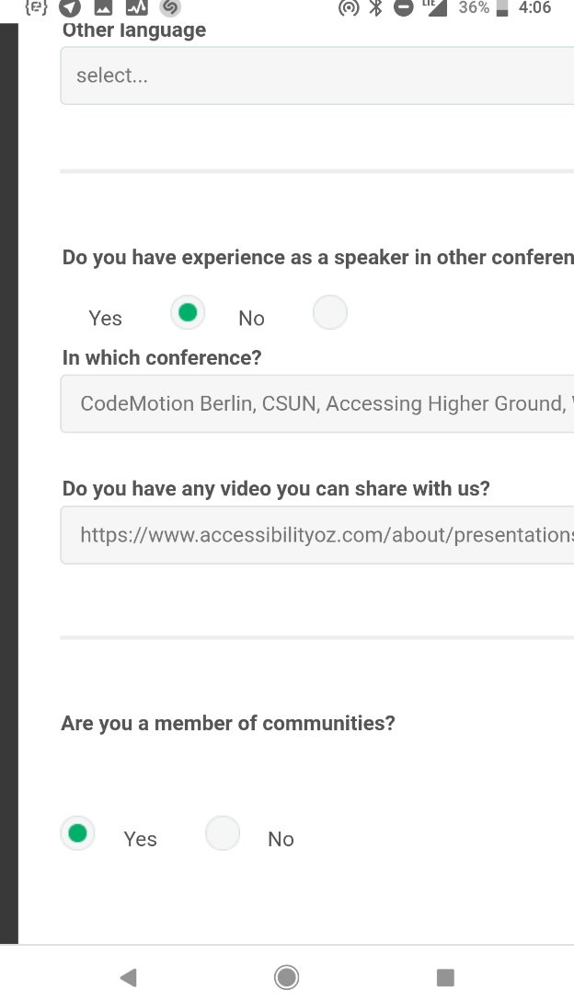
7.4: Positioned field labels
Fail – Input fields equidistant to field labels
Notes:
The radio button is equidistant from the Yes option and the No option. In addition to the unselected radio button not meeting colour contrast, it is not clear which option is selected.

Slide 110
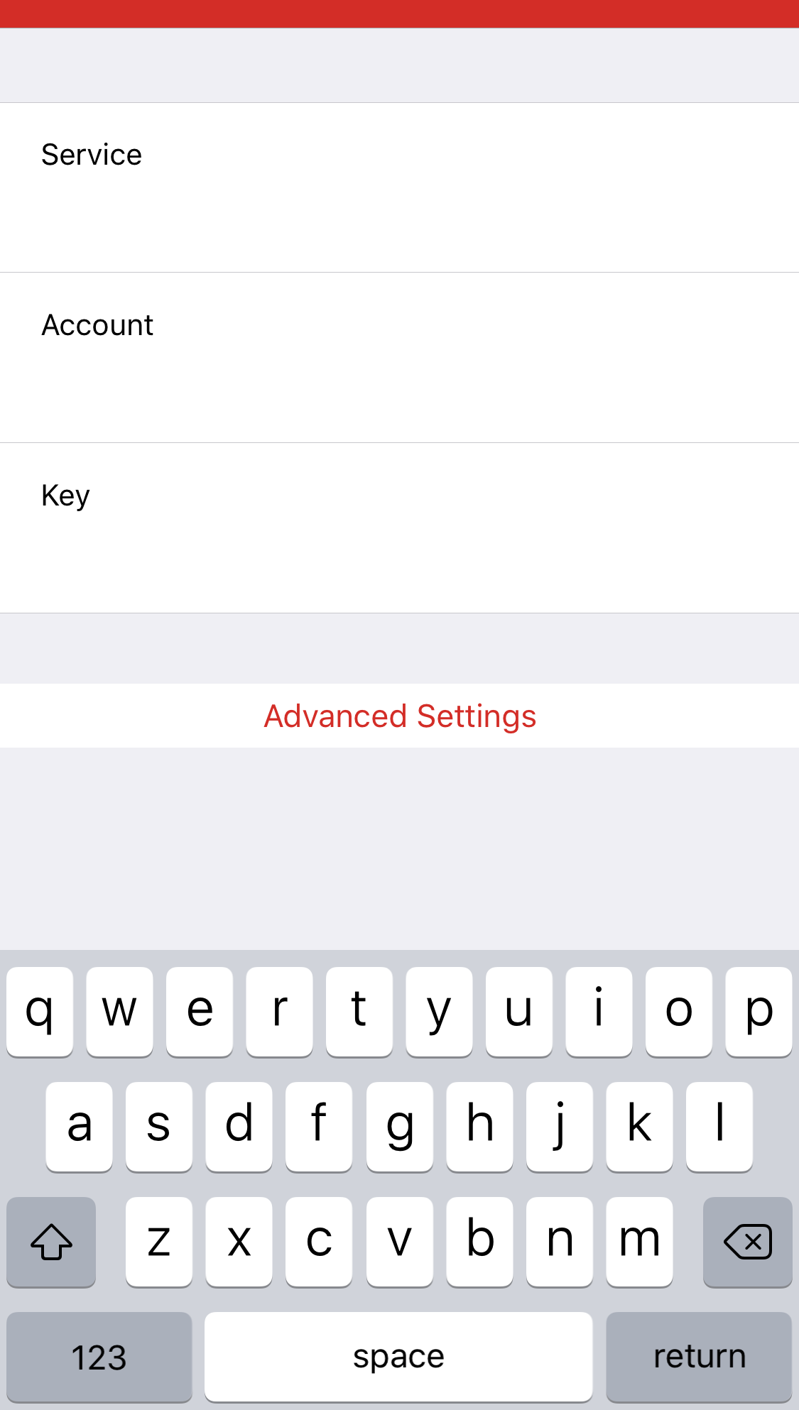
7.4: Positioned field labels
Fail – Differentiation has been provided but it is not sufficient
Notes:
Each field label (Service, Account, Key) is equidistant from the input field above and below the respective field. Although there is a border between one field and another, it does not meet colour contrast requirements.

Slide 111
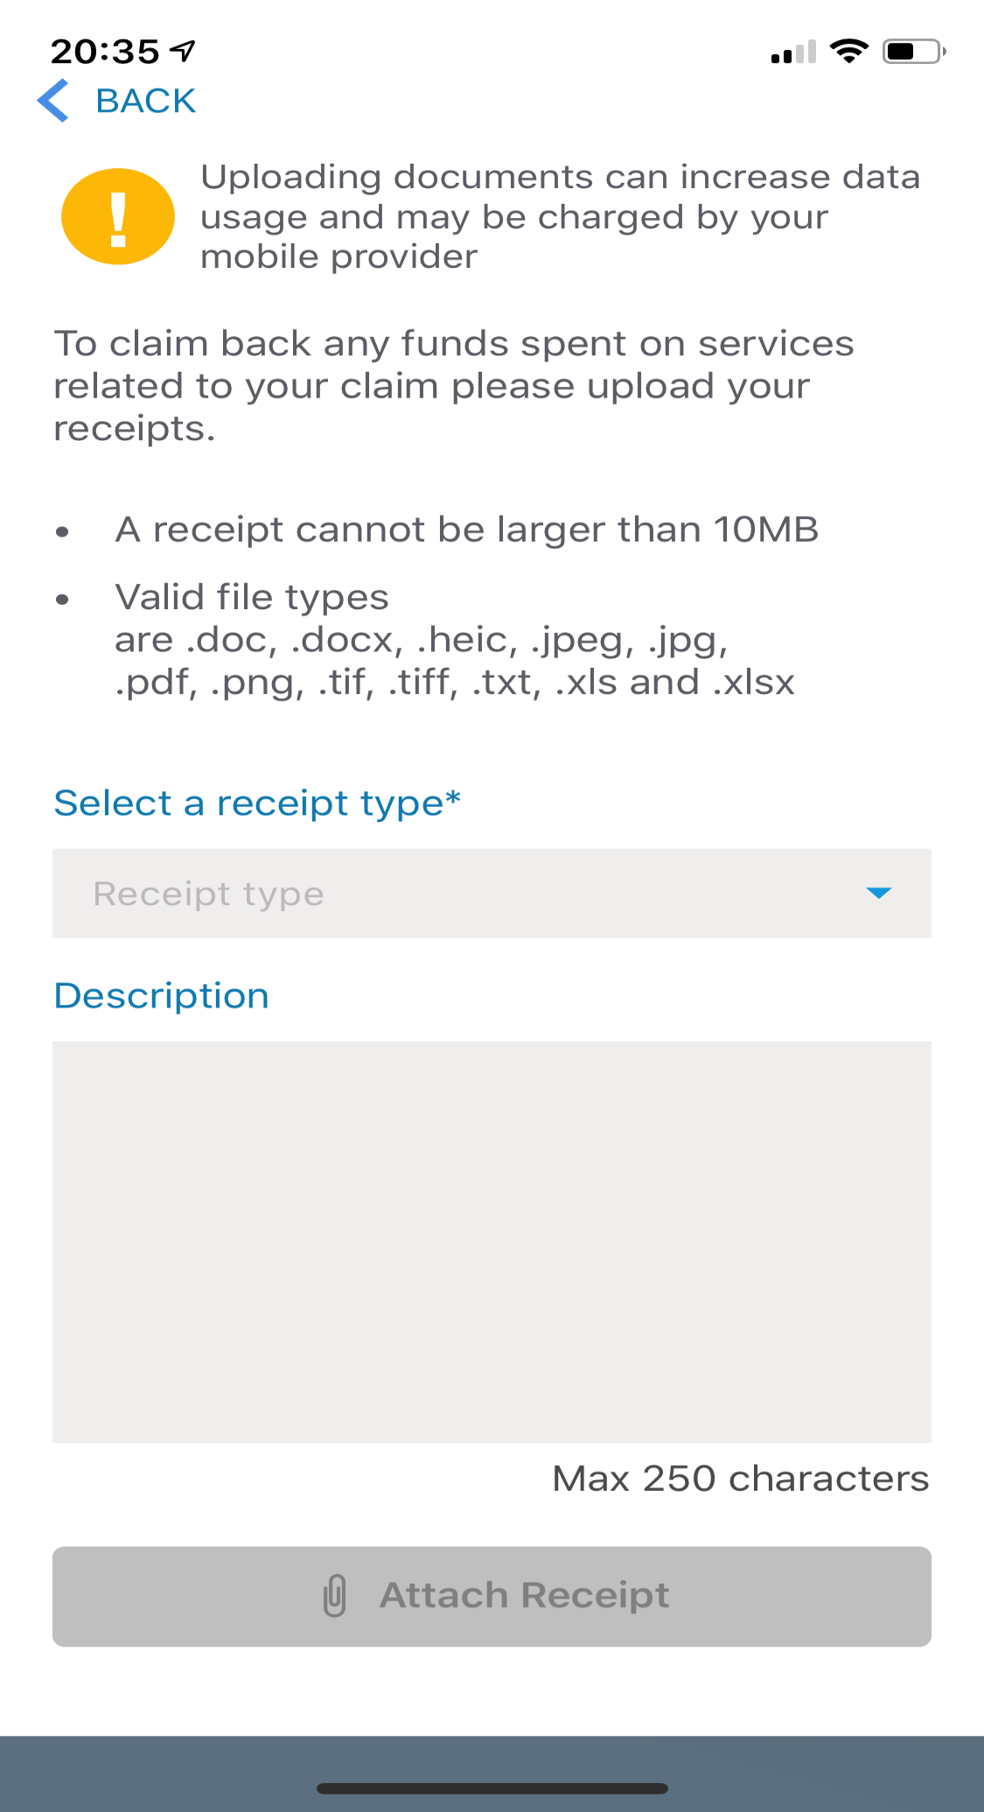
7.4: Positioned field labels
Pass – Input fields are located close to their field labels
Notes:
In this example, the field labels (Select a receipt type and Description) are closer to their respective input fields than to any other input field.

Slide 112
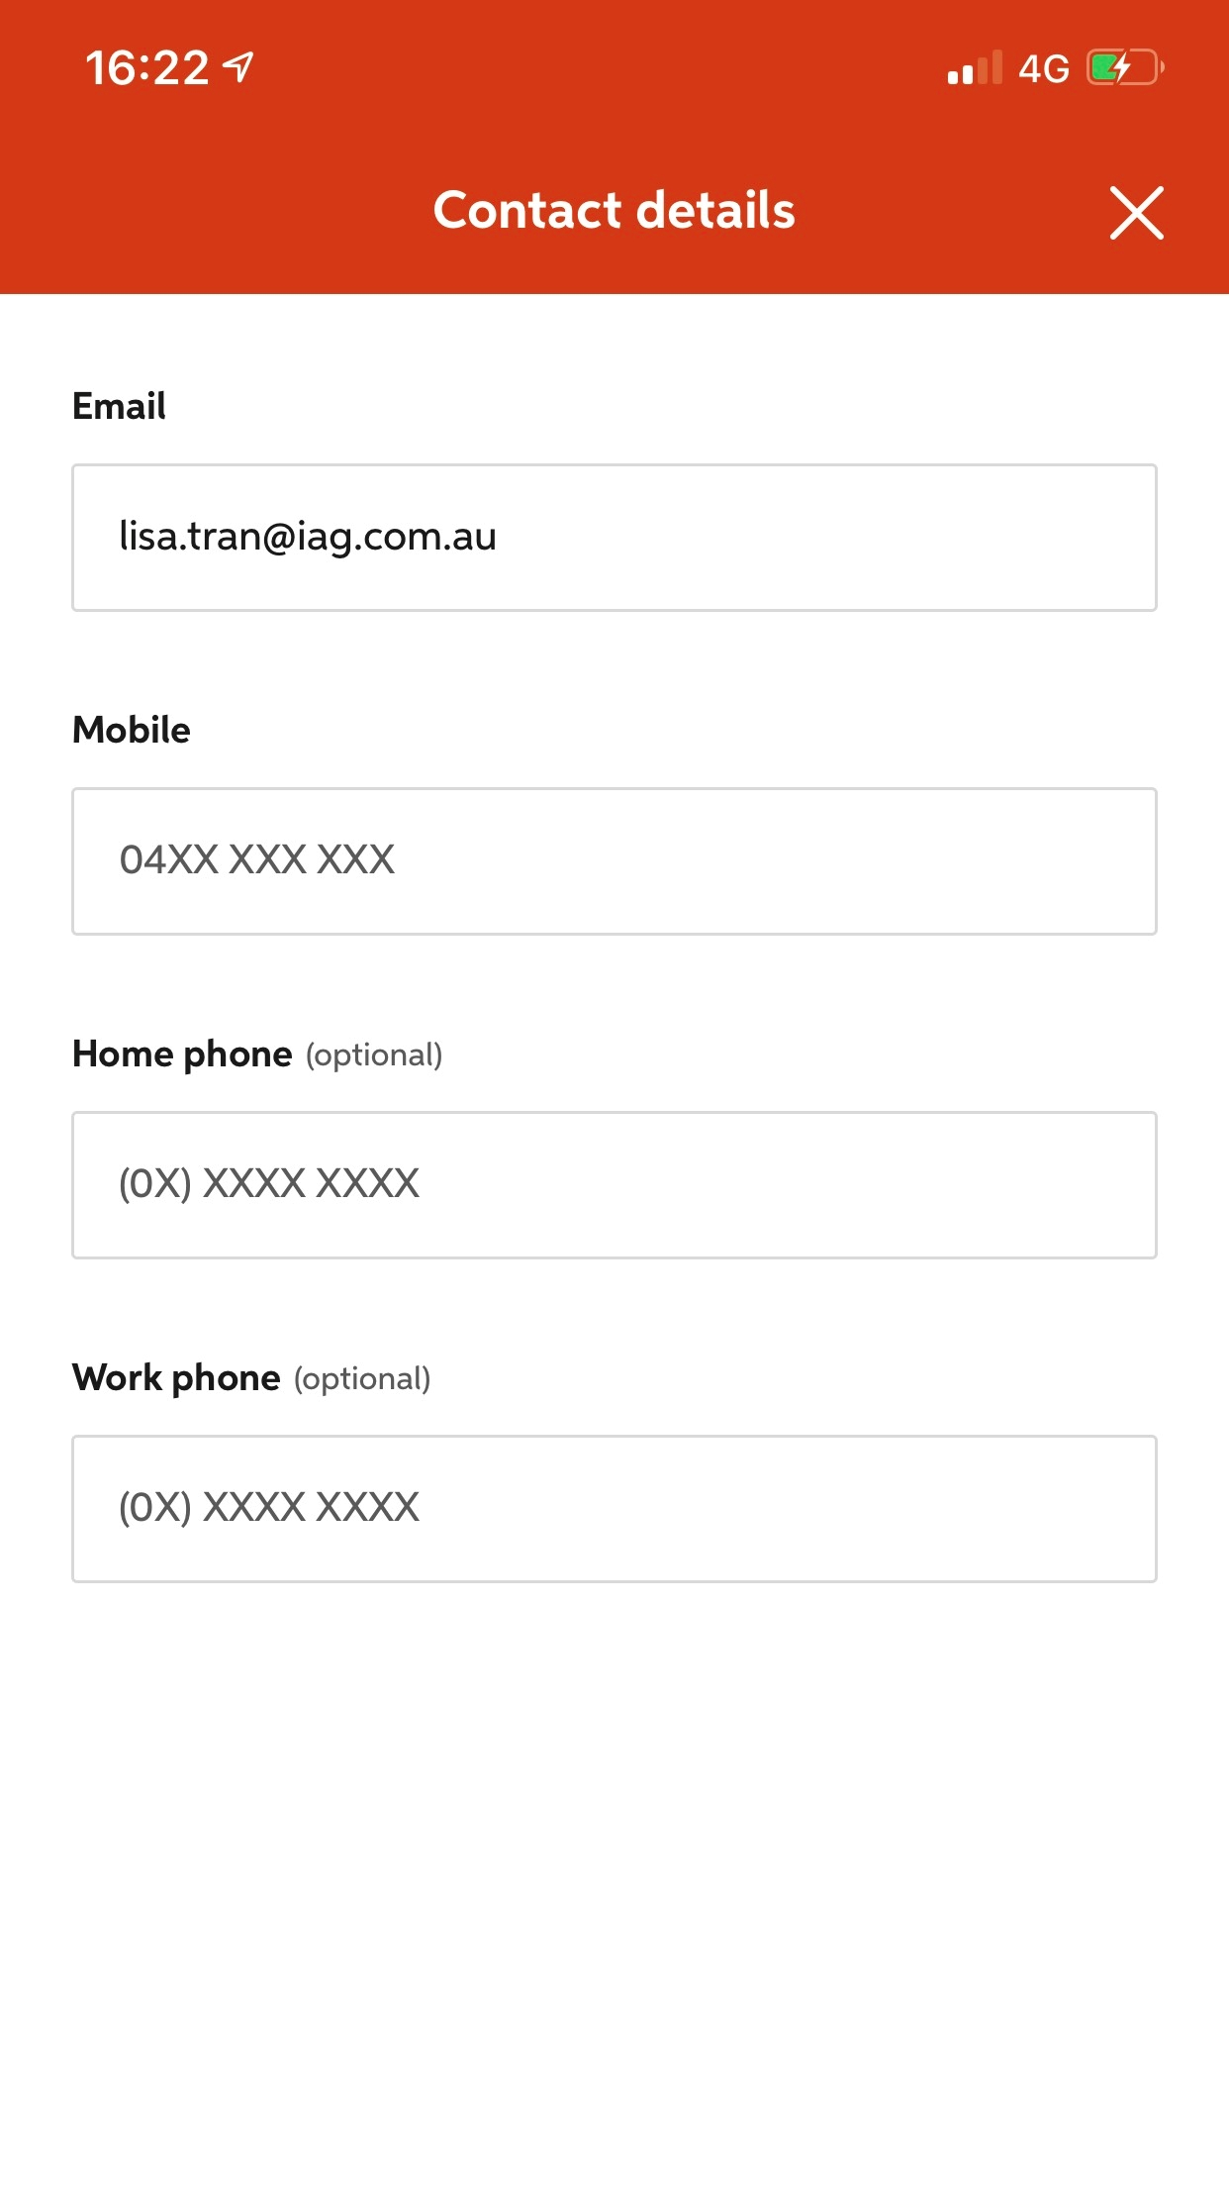
7.4: Positioned field labels
Pass – Input fields are located close to their field labels
Notes:
In this example, the field labels (Select a receipt type and Description) are closer to their respective input fields than to any other input field.

Slide 113
Test mobile assistive technology and feature support

Slide 114
Test mobile assistive technology and features
All actionable items and content can be accessed and activated by the following assistive technologies (or when the following feature is enabled)

Slide 115
Android assistive technologies and features
TalkBack
Keyboard
Keyboard and switch
Magnification
Remove animations
Invert colours
Grayscale
Increase display size
Increase text size (with Chrome)
Simplified view (mobile sites only)

Slide 116
iPhone assistive technologies and features
VoiceOver
Keyboard
Keyboard and switch
Zoom
Reduce Motion
Invert colours
Grayscale
Reader view (mobile site only)

Slide 117
iPad assistive technologies and features
VoiceOver
Keyboard
Keyboard and switch
Zoom
Reduce Motion
Invert colours
Grayscale
Reader view (mobile site only)

Slide 118
VoiceOver and TalkBack

Slide 119
VoiceOver (iOS)
All actionable items and content can be accessed and activated by VoiceOver on iOS.
Notes:
VoiceOver users include blind and low-vision users, as well as users with some cognitive or learning difficulties.

Slide 120
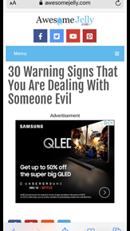
VoiceOver (iOS)
Fail – Link not identified properly
Notes:
In this example, the links in the highlighted region cannot be identified by VoiceOver as they simply read as “link.

Slide 121
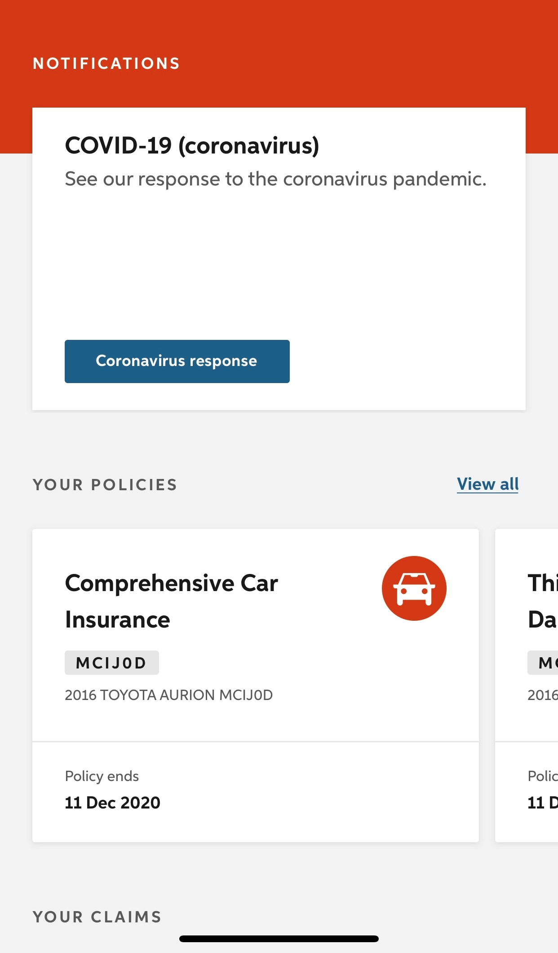
VoiceOver (iOS)
Fail – Coronavirus card is not actionable
Notes:
Coronavirus card is read by VO but is not actionable

Slide 122
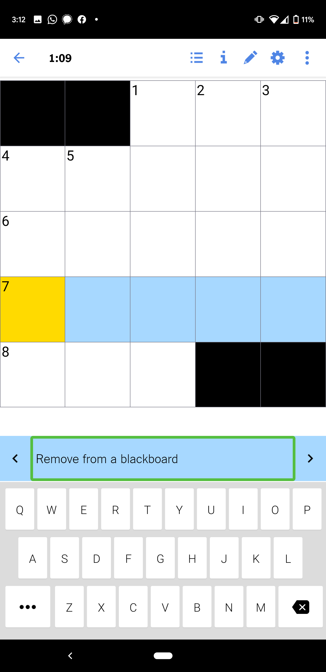
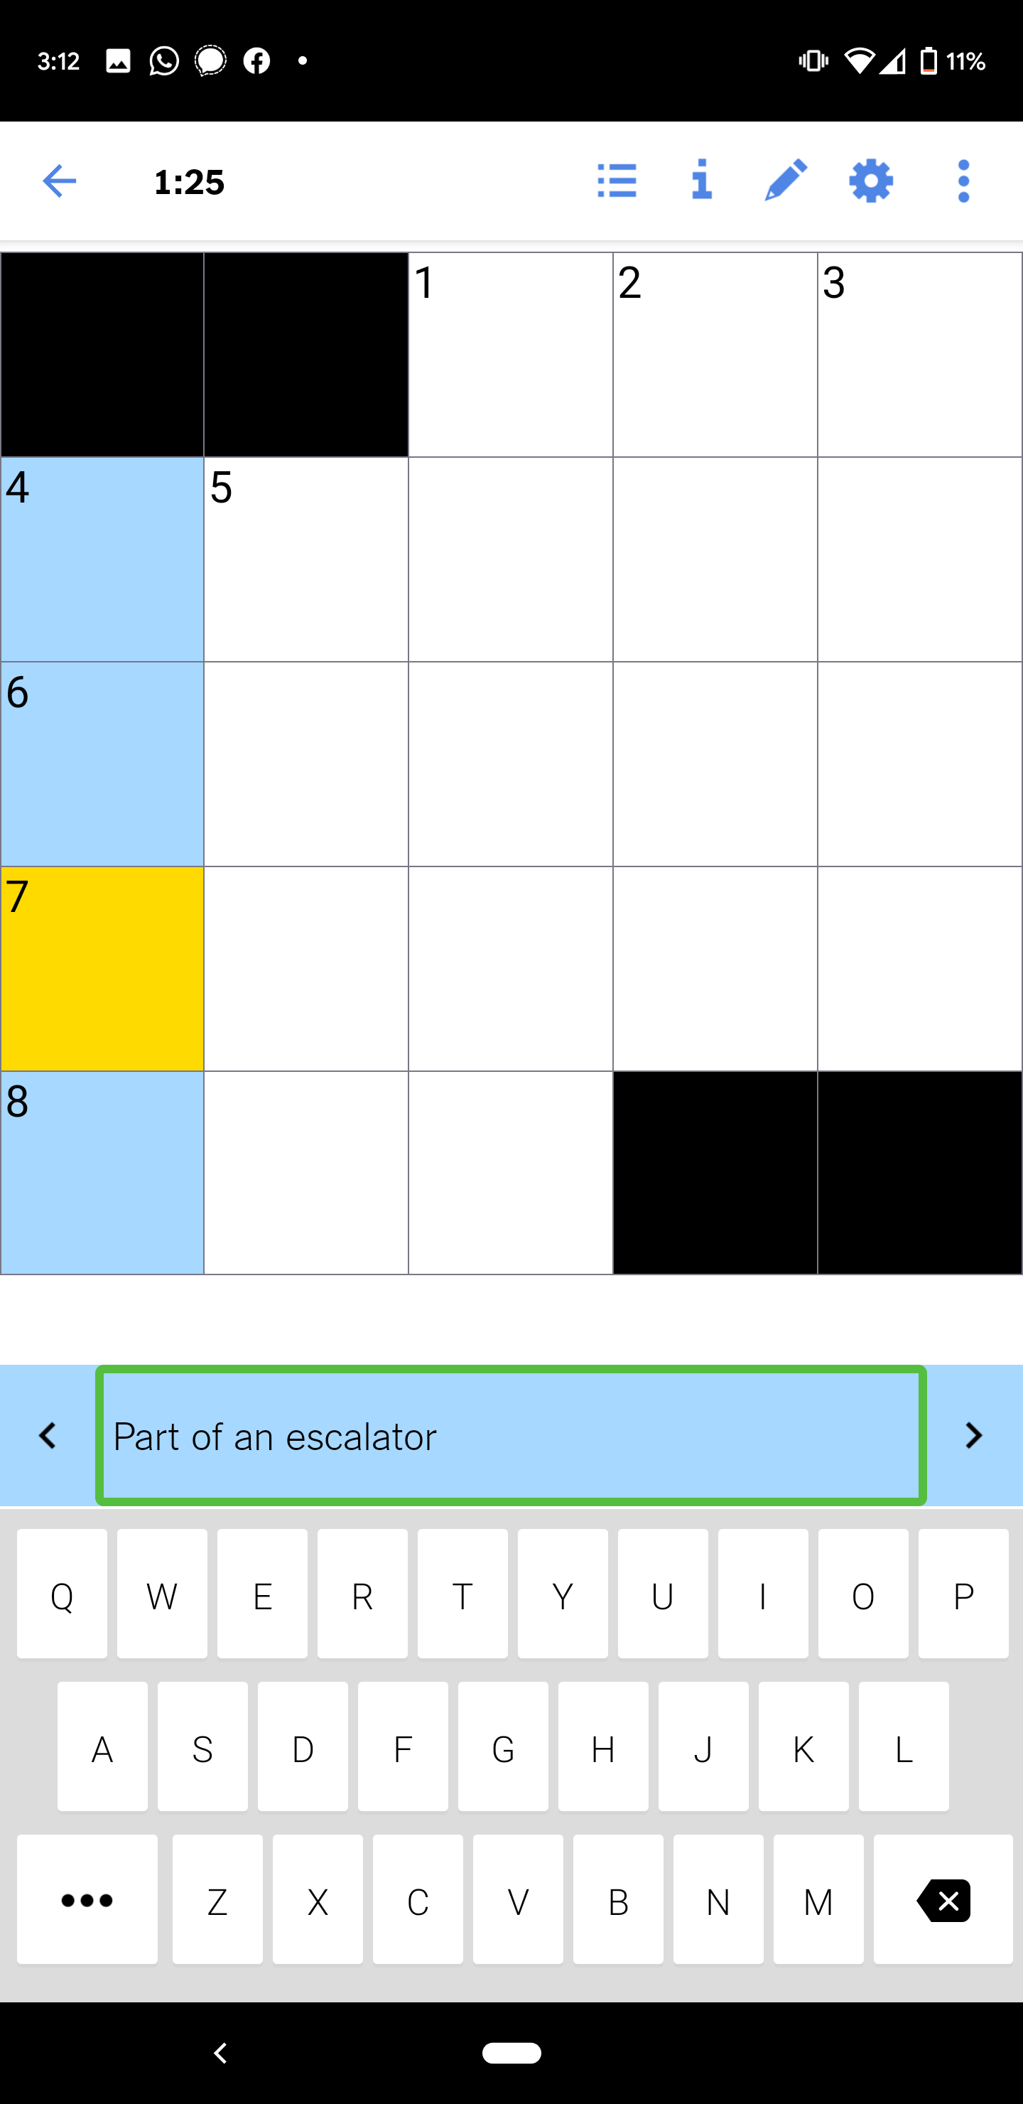
TalkBack (Android)
Fail – Activation does not move focus to next logical item
Notes:
In this crossword app, when TalkBack is focused on an across clue, activating that clue won’t take the user to the crossword, but instead swap to a down clue. Fig. 1: Across clue in focus. Fig. 2: On activating the clue.

Slide 123
What’s next?

Slide 124
Updates from WCAG2.2

Slide 125
Updates from WCAG2.2
The two additional Level A success criteria are (my description):
3.2.6: Consistent help – providing consistent help mechanisms
3.3.9: Redundant Entry - Information previously entered is auto-populated
Notes:
Should be released in April 2023

Slide 126
Updates from WCAG2.2
The five additional Level AA success criteria are (my description):
2.4.11: Focus Appearance – ensuring the keyboard focus indicator is visible to all
2.4.12: Focus Not Obscured – the current keyboard focus is not hidden
2.5.7: Dragging Movements – dragging has an accessible alternative
Notes:
Should be released in April 2023

Slide 127
Updates from WCAG2.2
…
2.5.8: Target Size (Minimum) – targets have an adequate size
3.3.7: Accessible Authentication – providing easy methods of authentication
Notes:
Should be released in April 2023

Slide 128
Updates from WCAG2.2
The two additional Level AAA success criteria is (my description):
2.4.13: Focus Not Obscured (Enhanced) – the entire keyboard focus is visible
3.3.8: Accessible Authentication (Enhanced) – providing easy methods of authentication
Notes:
Should be released in April 2023

Slide 129
Additional assistive technologies / mobile features

Slide 130
Additional assistive technologies / mobile features
Some additional assistive technologies / mobile features
Voice Control
Increasing text size / font color from Reader View
Testing with a mouse
Notes:
Should be released in September 2022

Slide 131
Review of existing test cases

Slide 132
Review of existing test cases
Some test cases need review, for example:
Text-to-Speech traps were only in the Native App methodology, however they have begun to occur on Mobile Sites
Notes:
Should be released in September 2022

Slide 133
Removal of some assistive technologies / mobile features

Slide 134
Removal of some assistive technologies / mobile features
Certain types of tests tend to generate the same results and need to be removed:
Grayscale (in iOS and Android), Color Inversion (in Android), and Invert Colors (in iOS) always fail together or pass together
Reduce Motion (iOS) and Remove Animations (in Android) always fail together or pass together
Classic Invert doesn’t provide any additional testing information to Smart Invert
Notes:
Should be released in September 2022

Slide 135
Creation of online resource

Slide 136
Creation of online resource
Currently these are Word documents, but it would be better to be a web site which is:
Searchable
Easily updated
More likely to be used
AND
More accessible!
Notes:
Should be released in September 2022

Slide 137
Thank you for coming today

Slide 138
Get involved in the mobile committee
Get involved!
mobile23@
accessibilityoz.com

Slide 139
PLEASE PROVIDE YOUR FEEDBACK!
https://mid.camp/6894

Slide 140
Access this information
Access this presentation and all links at pz.tt/mobile23

Slide 141
About our services
Website & Application Audits
Mobile
Testing
Accessible Word, PDF & HTML
On-site & Online Training
Video
Accessibility
User
Testing
Support hours & OzWiki access
Accessibility during web development

Slide 142




About our products
Factsheets
CCC videos
More information: www.accessibilityoz.com

Slide 143
Contact AccessibilityOz
@accessibilityoz
AccessibilityOz
enquiries
@accessibilityoz.com

