Slide 1
Preprocess All The Things!
Slides pinned on twitter:
@redbrickone
Notes:
Hi, my name is Chris Wright. You can find me on twitter and other platforms with the tag @redbrickone. I work for Code Koalas in Kansas City working on Drupal sites.
Like most developers, I like watching the Office and pulling pranks on my coworkers.

Slide 3
Preprocess Functions
What they do
How to use them
Helpful tools and tips to make your life easier
Notes:
Today we will be talking about Preprocess Functions, what they do, how to use them and some helpful tools and tips to make your life easier in theming and twig.

Slide 5
What are preprocess functions?
Set up variables to be placed in a template
Change how content is rendered
Change what information is served up to the page
Add custom logic before it hits the page
Notes:
What do are preprocess functions and what do they do? Modules in core and in contrib create and serve up data that will be rendered on the page. If you need to change how that content is rendered, what information is served up or add some custom logic before it hits the page, preprocess functions are what you are looking for.
The main role of preprocessors is to set up variables to be used in a template. These variables can contain complex renderable arrays or at its’ simplest, boolean values. Most of the logic should be kept in the preprocessors to keep templates markup clean and easy to navigate through and work with.

Slide 6
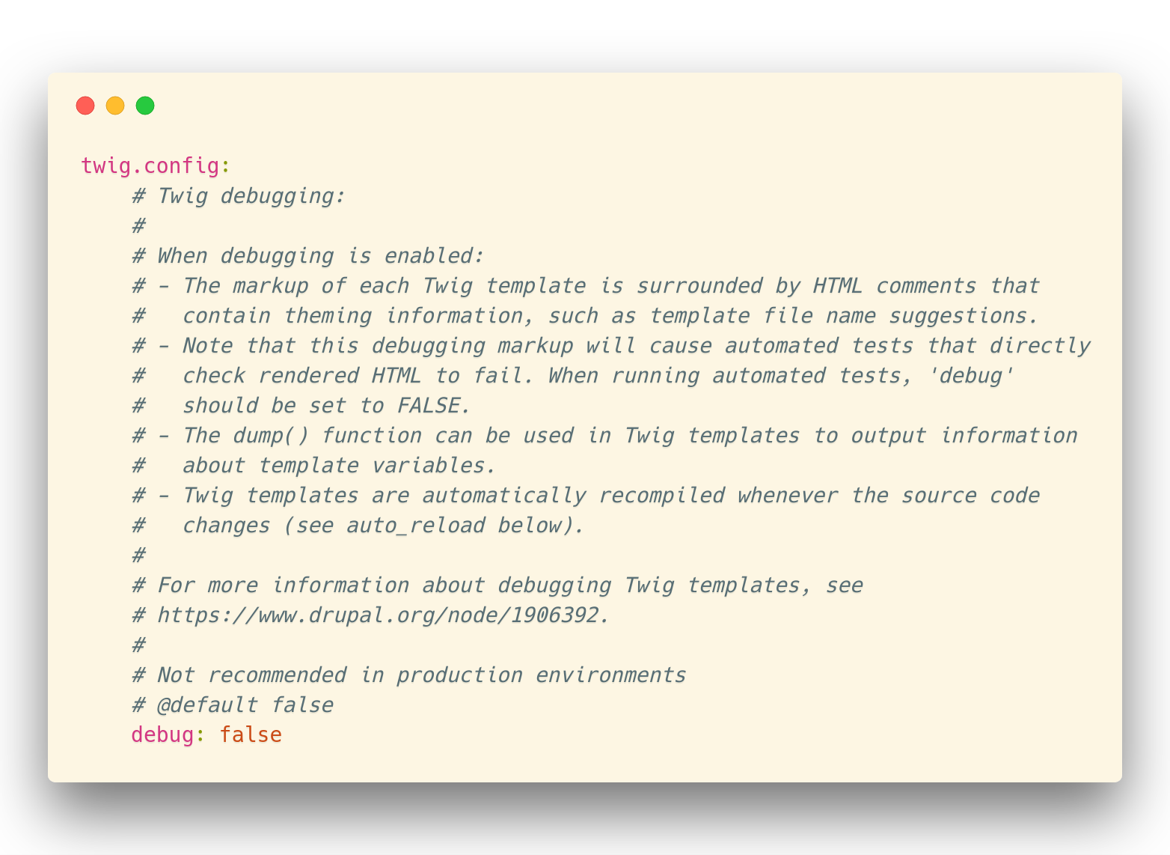
Turn on Debugging
In /sites/default/services.yml, modify under Twig: debug:false to be debug:true
Notes:
debugging is essential for preprocessing elements on your site.
First, if you haven’t already, navigate your code to your services.yml file.
It should be located in /sites/default/services.yml. Under Twig, change debug: false, to debug:true.

Slide 7
Turn on Debugging
This will now show templating suggestions and theme_hooks in comments throughout the html of your site
Notes:
This will now show templating suggestions and theme_hooks in comments throughout the html of your site.

Slide 8
Theme Debug

Slide 9
Theme Debug

Slide 10
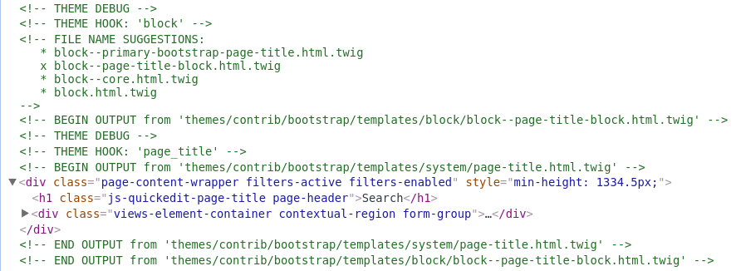
Theme Debug

Slide 11
Template.php?
D8: themename.theme file rather than a template.php file as in D7
Try to keep logic in .theme file and out of your templates
Notes:
In Drupal 8, preprocessing is not that different than Drupal 7, although you will be writing your php code in the themename.theme file rather than a template.php file.
You should keep most of your code logic inside this file and use the templates for rendering the content as it should be output rather than cluttering up templates with logic that could simply be done in php in your theme.

Slide 12
Preprocess Function format
function themename_preprocess_HOOK(&$variables) {}
HOOK is the element you wish to preprocess
Preprocess basic things like nodes, pages, etc or get more in depth and preprocess fields, exposed filters or even forms
Use debugging to find the specific theme_hook to use
Notes:
Preprocess Functions follow this format: themename_preprocess_HOOK, where the HOOK is the theme_hook of the element you want to preprocess. At their simplest, you can use theme_preprocess_node or page if you want to change how things render on a page or node, but what if you wanted to modify something more specific, say a field, exposed filter or a form? Well, you can look for the element in your html and with twig debugging enabled, it will actually tell you what theme_hook it is using. You can use the same theme_hook in your preprocess function to modify that element.

Slide 13
Preprocess radio button exposed filter
Find the theme_hook - bef_radios
function themename_preprocess_bef_radios(&$variables) {}
Notes:
For instance, if you wanted to modify radio buttons from an exposed filter in a view using the Better Exposed Filters module, you would find the theme_hook is bef_radios, so your preprocess function would then be themename_preprocess_bef_radios(&$variables).

Slide 14
Viewing Variables
Devel Module
kint()
ksm() (similar to dpm)
Xdebug

Slide 15
Devel module functions
kint($variables);
ksm($variables);
Clear the cache
Navigate to the page
Profit

Slide 16
Kint
Ksm();

Slide 17
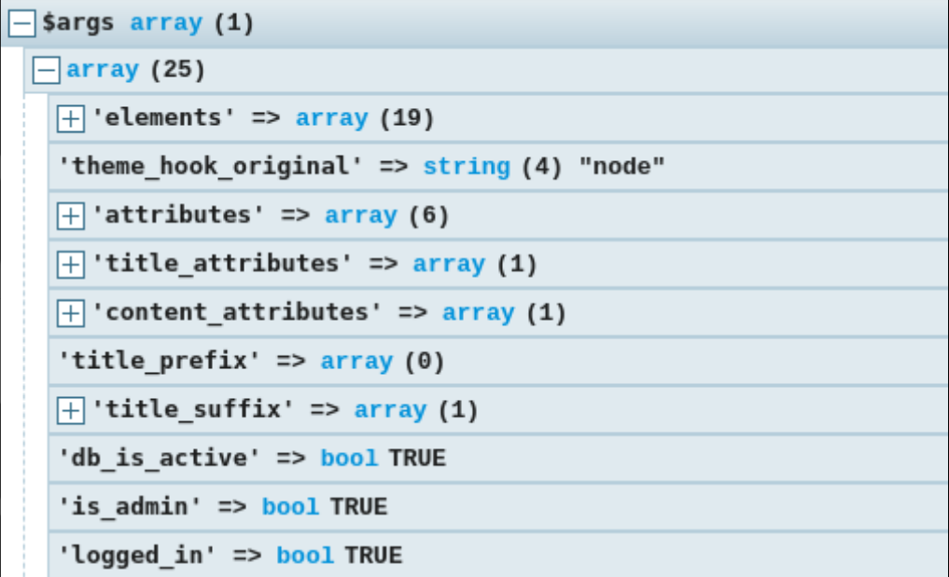

Slide 18
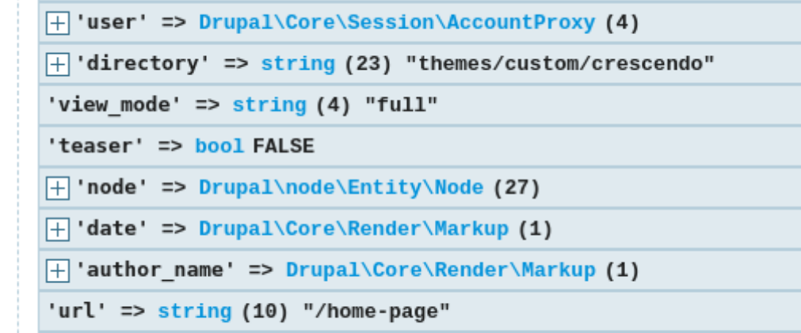

Slide 19
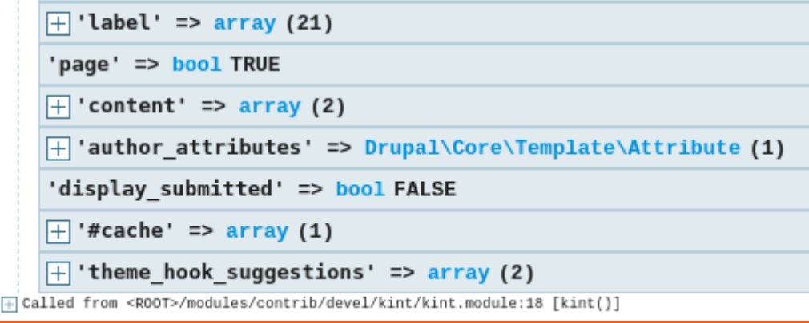

Slide 20
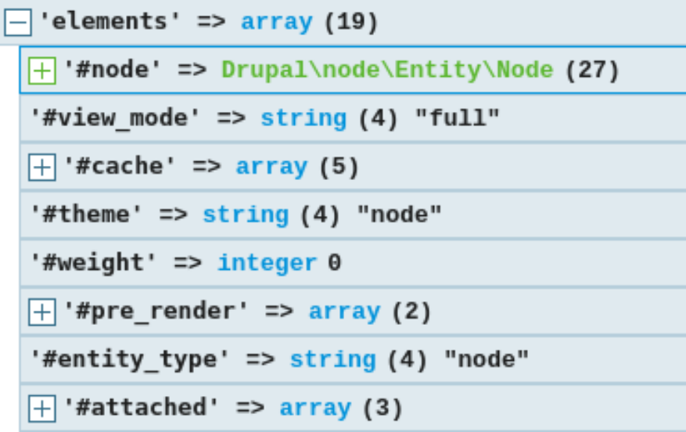

Slide 21
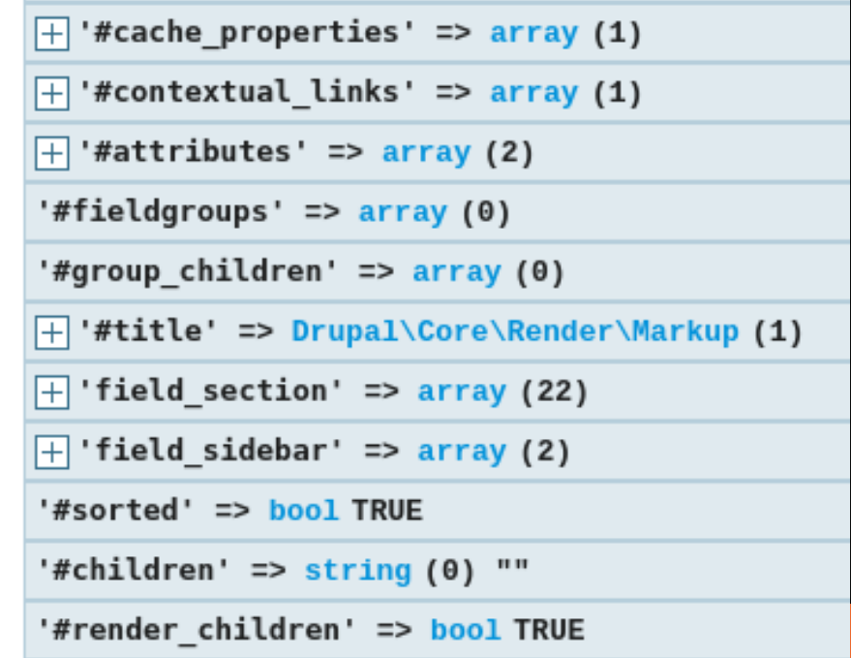

Slide 22
Xdebug
Add a breakpoint inside your function
Clear cache
Run Xdebug
Navigate to the page
Profit

Slide 23
Setting up Xdebug? Not that crazy
https://joshfabean.com/blog/xdebug/

Slide 24
Add Classes to element or wrapper
Add or modify classes inside $variables[‘classes_array”]

Slide 25
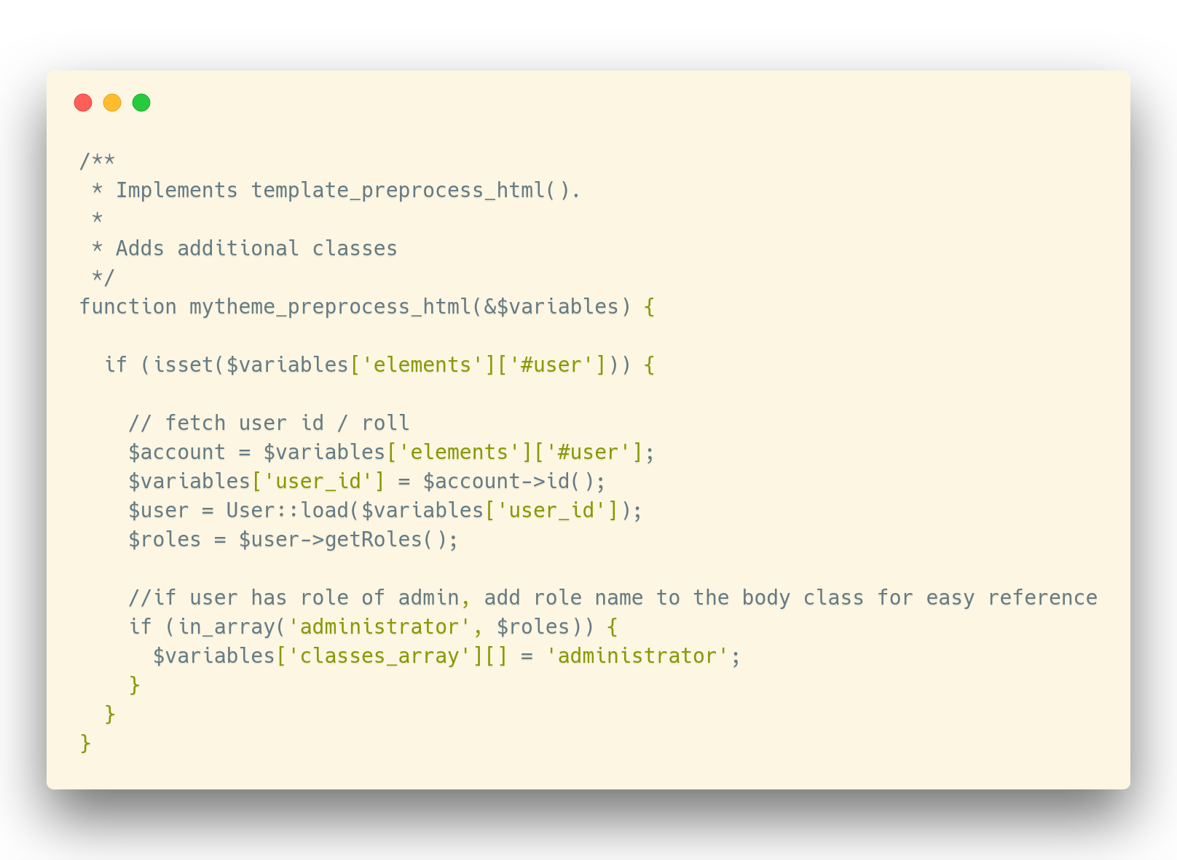
Add Classes to element or wrapper

Slide 26
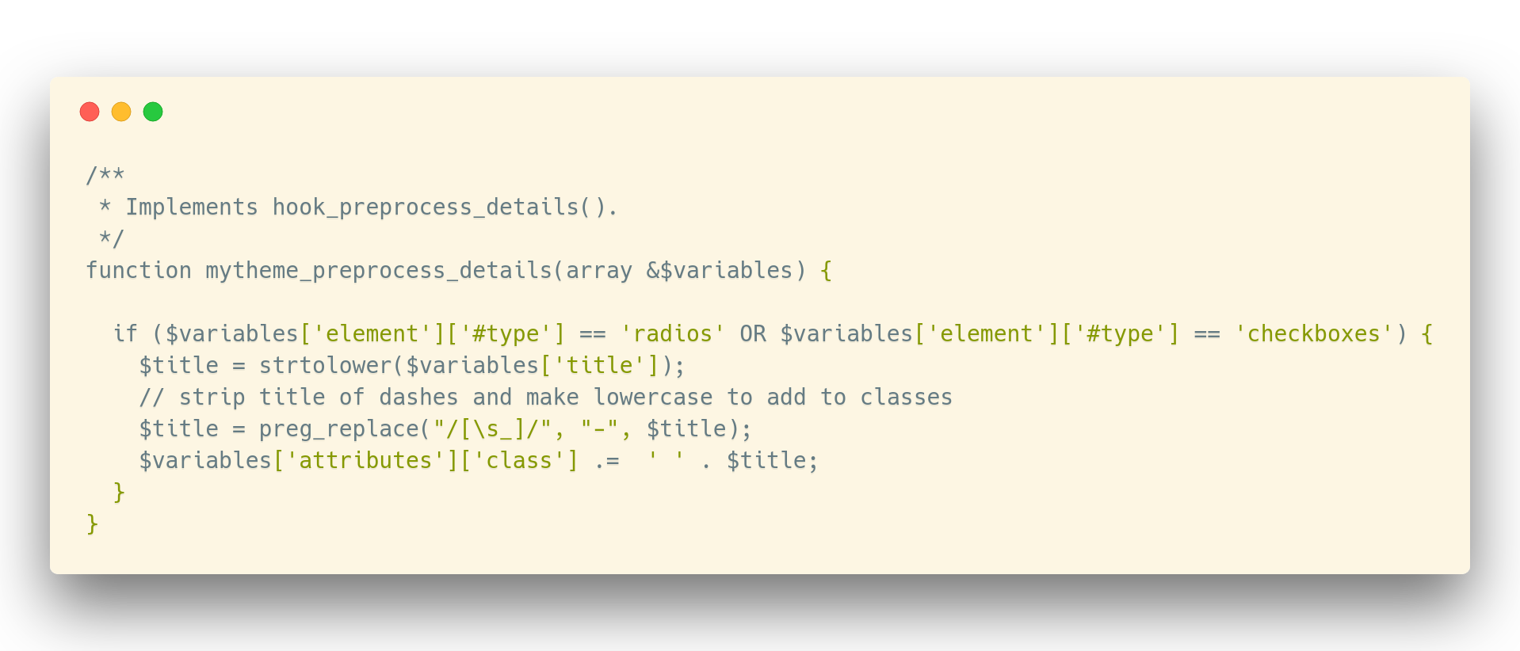
Add exposed filter titles to wrapper classes

Slide 27
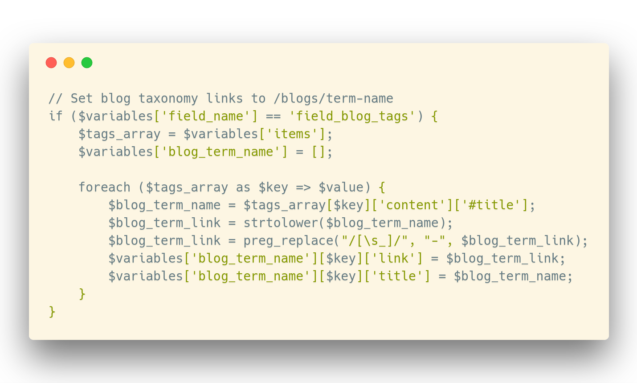
Preprocess a Field

Slide 28
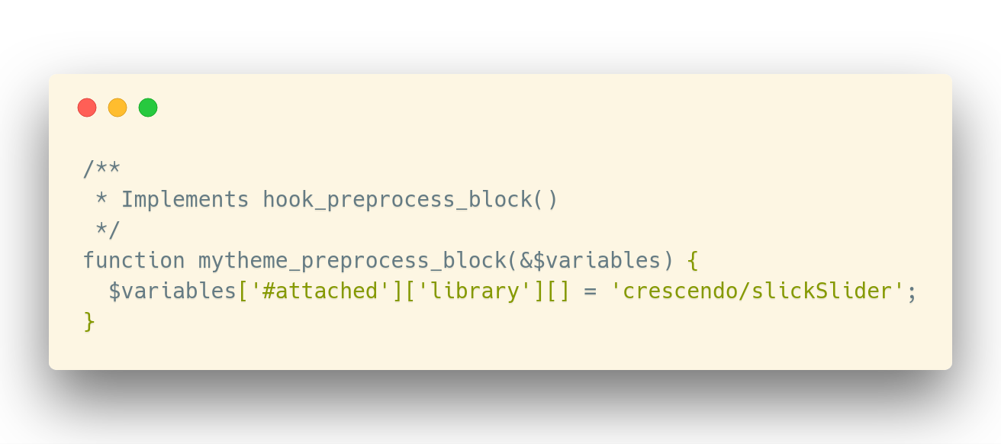
Add Javascript to a Block

Slide 29
Renderable Arrays
Creating them
Calling / using them in the twig template
Why you would use them
Notes:
Renderable arrays are better to use than html bc people
Adding block to a page, you could write html but if it might be slightly different later OR you are writing a module you want to contribute,
You use a render array so people can easily hook into it later
You are writing reusable code

Slide 30
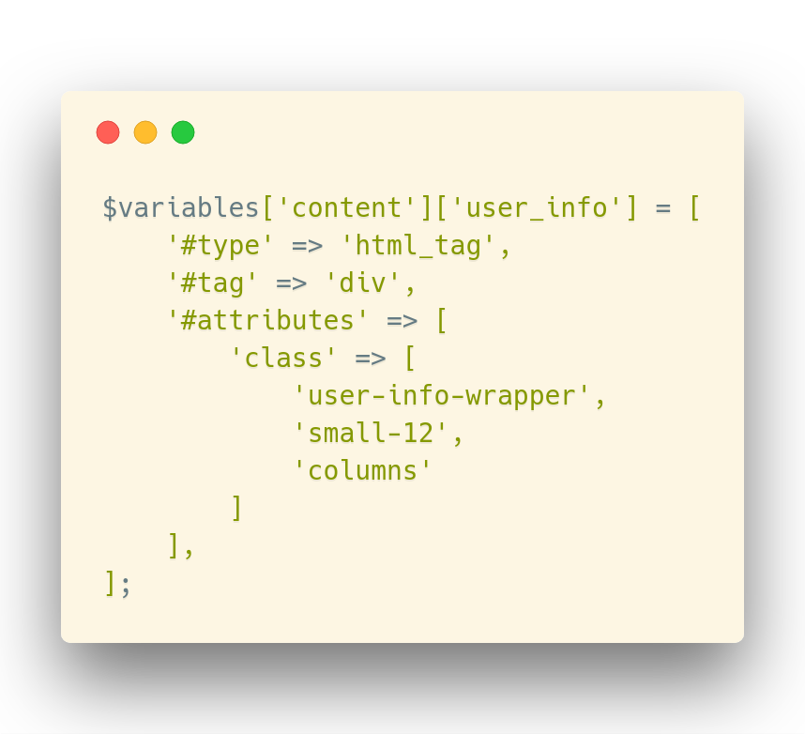
Renderable Array

Slide 31
Renderable Array

Slide 32
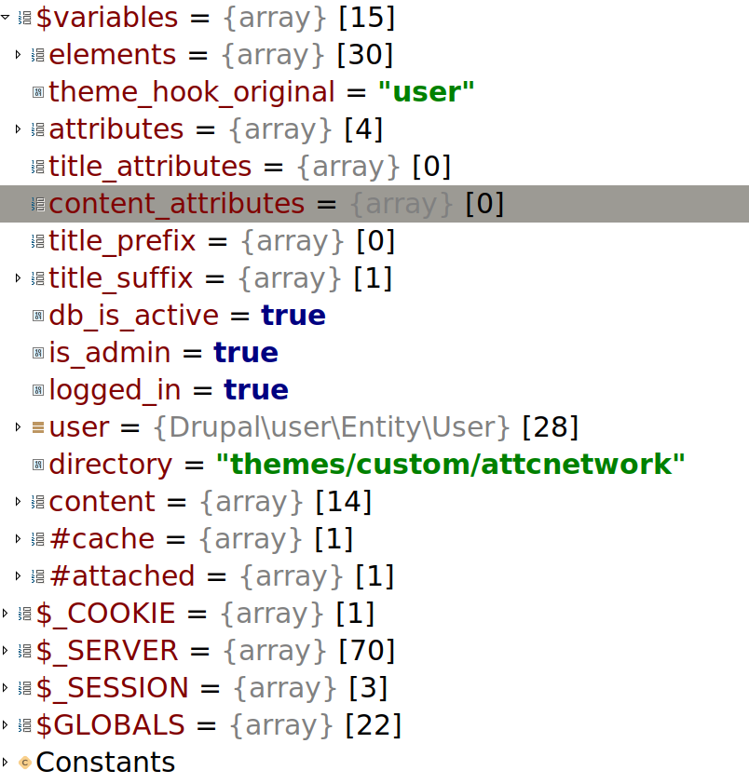

Slide 33
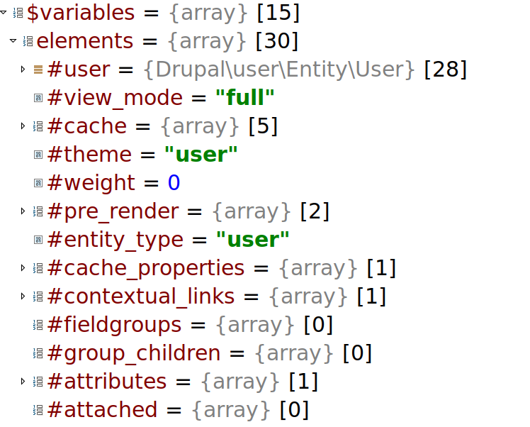

Slide 34
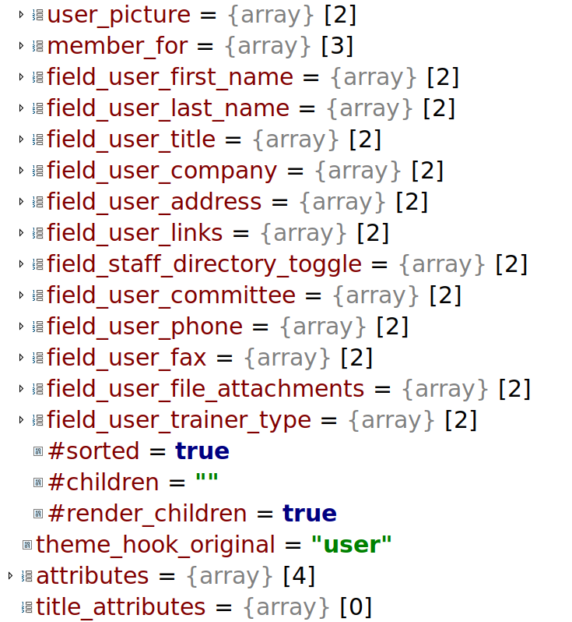

Slide 35
XDebug

Slide 36
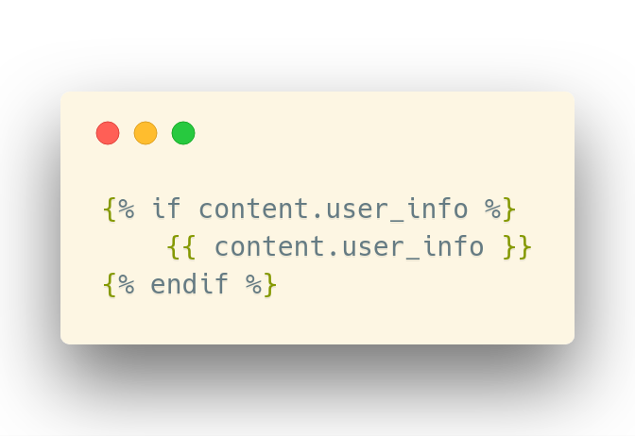
Renderable Array - Twig

Slide 37
Theming Template Suggestions
Allows you to add a specific template naming suggestion format
Can be used globally or for specific use cases
hook_theme_suggestions_HOOK_alter

Slide 39
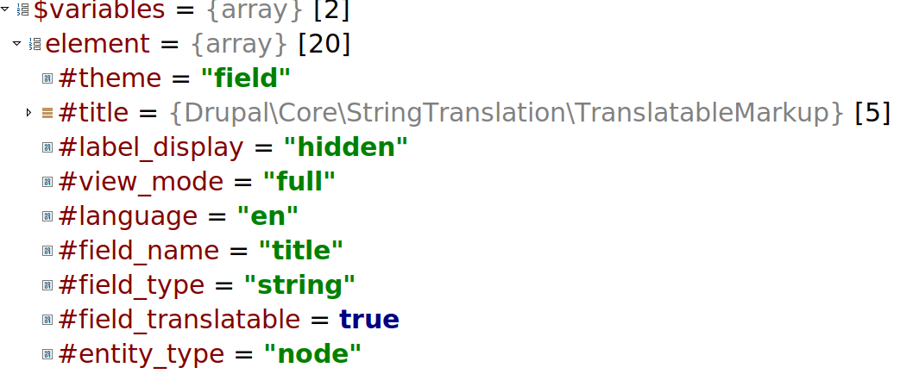

Slide 40
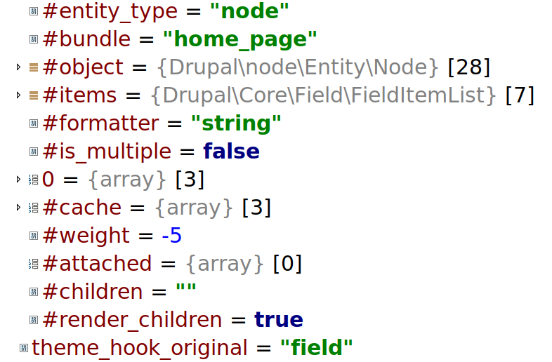

Slide 41
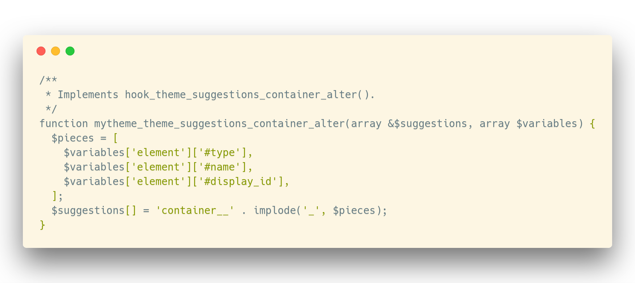
Theming Template Suggestions

Slide 42
Twig
Variables will be called by their associative key “$variables[‘footer’]” will be called “footer” in twig
If thrown inside content - $variables[‘content’][‘footer’], you will use dot notation i.e. content.footer
Can use if checks in twig {% if content.footer %}, etc

Slide 43
Modifying Forms
Add a link to a form
Be careful not to leave new form items vulnerable to XSS attack

Slide 44
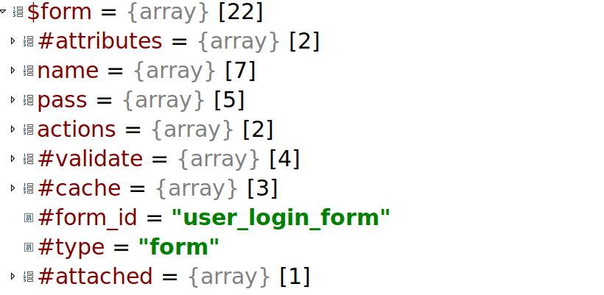

Slide 45
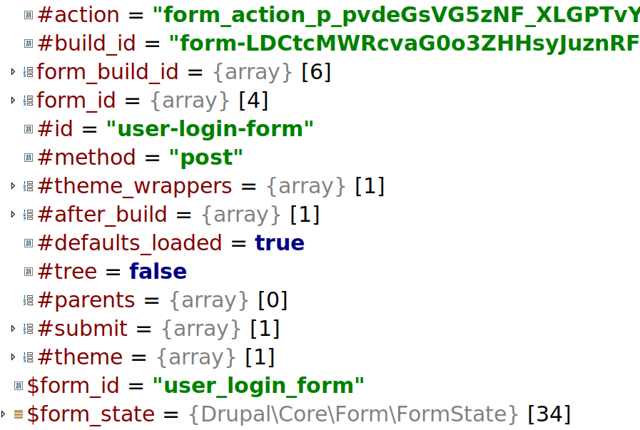

Slide 46
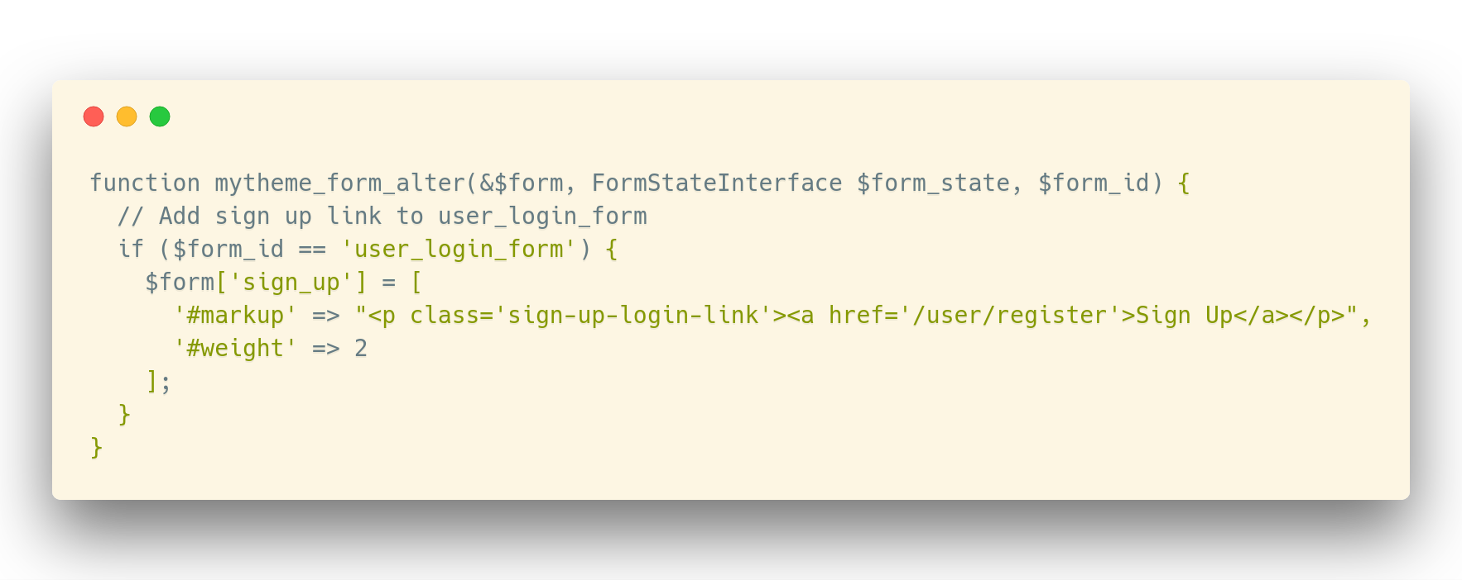
Modifying Forms

Slide 47
Preprocess All The Things!
What they do
How to use them
Helpful tools and tips to make your life easier

Slide 48
Preprocess Functions
What they do
How to use them
Helpful tools and tips to make your life easier
Notes:
Today we will be talking about Preprocess Functions, what they do, how to use them and some helpful tools and tips to make your life easier in theming and twig.

Slide 49
Useful Links
Debugging:
https://www.drupal.org/docs/8/theming/twig/locating-template-files-with-debugging
https://www.drupal.org/docs/8/theming/twig/discovering-and-inspecting-variables-in-twig-templates
Template Suggestions:
https://www.drupal.org/docs/8/theming/twig/working-with-twig-templates
https://www.drupal.org/docs/8/theming/twig/twig-template-naming-conventions
https://api.drupal.org/api/drupal/core%21lib%21Drupal%21Core%21Render%21theme.api.php/function/hook_theme_suggestions_alter/8
Render Arrays:
https://www.drupal.org/docs/8/api/render-api/render-arrays
https://api.drupal.org/api/drupal/core!lib!Drupal!Core!Render!theme.api.php/group/theme_render/8.2.x

Slide 50
Now you can say...
Let’s connect!
Twitter: @redbrickone
Website: redbrickone.com
Taco Blog: taco.ist
codekoalas.com/koala/chris-wright

